Slide 1
Surveying a Sterile Processing Department - ASC
Notes:
SCRIPT NOTES:
Welcome to STERIS University’s program Surveying a Sterile Processing Department - ASC.

Slide 2
Disclosures
Notes:
SCRIPT NOTES:
Before we start, let’s review the disclosures. STERIS is offering the continuing education credits for this program. Participants must complete the entire program and submit an evaluation to receive their certificate. No partial credit will be given.
The presenter is an employee of STERIS. All fees and costs associated with development of this program was provided by STERIS.
Any product seen or referred to in this program does not constitute commercial support by STERIS or the speaker.
Additional information
None

Slide 3
STERIS Corporation is an approved provider of continuing nursing education by CBRN – provider # CEP 11681 and an approved Administrator Education Unit (AEU) and Infection Prevention Control (IPCH) provider by BASC – provider # 1417.
This program is approved for:
  0 hour(s) of GI Specific content credit by ABCGN (American Board of Certification for Gastroenterology Nurses),
  1.5 AEU(s) & 1.5 IPCH(s) by BASC (Board of Ambulatory Surgery Certification), and
  1.5 contact hour(s) of continuing education credit
    CBRN (California Board of Registered Nursing);
    CBSPD (Certified Board for Sterile Processing and Distribution); and
    HSPA (Healthcare Sterile Processing Association).
Notes:
SCRIPT NOTES:
This program has been credentialed for (read the value, abbreviated credited hour and abbreviation of the credentialing agent. For example:. 1 hour of GI specific content by ABCGN)
Additional information
None

Slide 4
Notes:
SCRIPT NOTES:
Through our partnership with CCI, CE earned through CBRN may be used towards your CNOR and CSSM recertification requirements.
Additional information
None

Slide 5
Review infection prevention challenges specific to ASCs
Identify areas for improvement that focus on decreasing healthcare infections

Slide 6
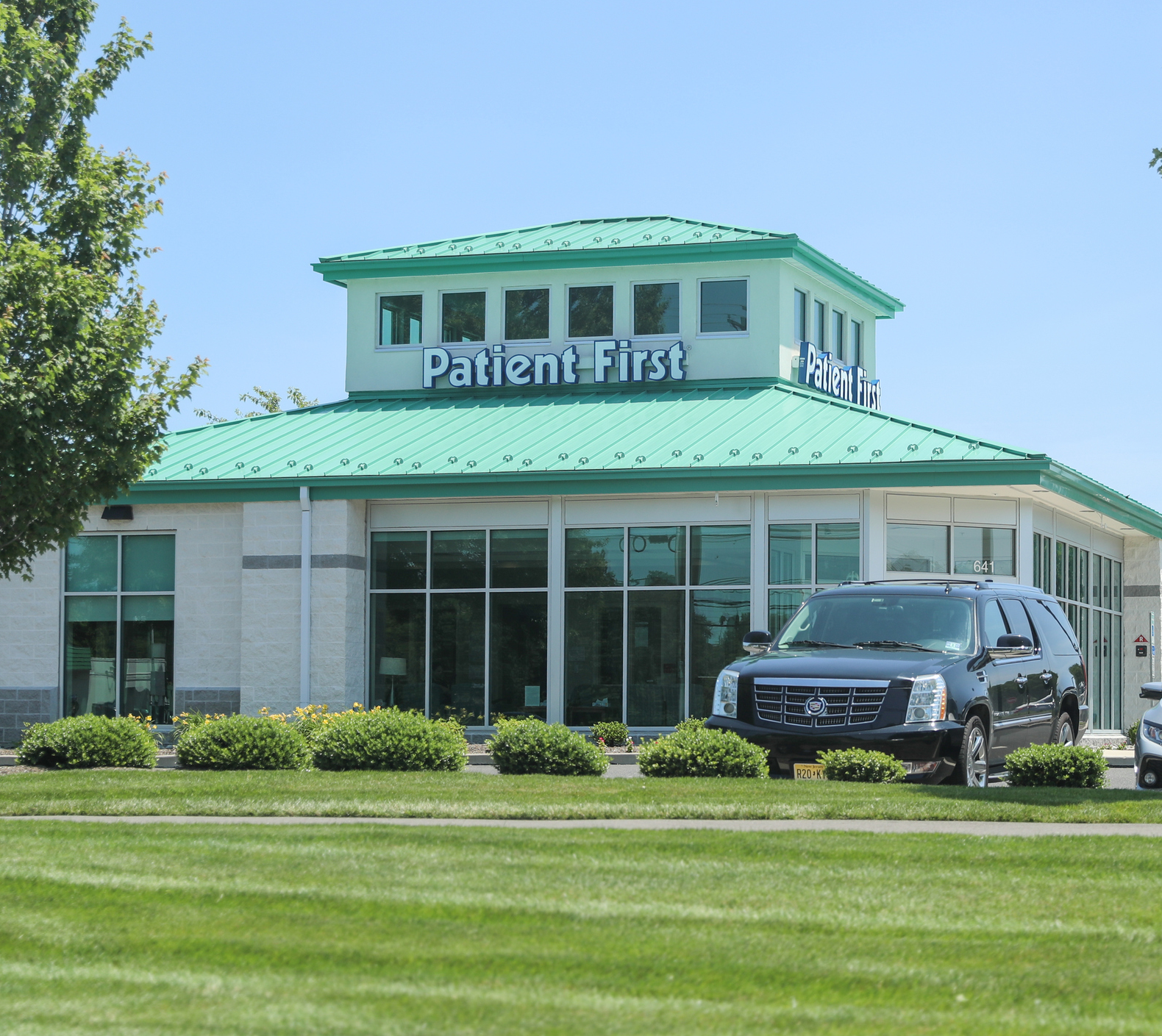
Common Processing Challenges for ASCs
Space constraints
Caseload vs. reprocessing speed
No dedicated SPD staff
Lack of education or competency
Notes:
Specific to ASCs
SCRIPT NOTES:
One aspect of my job is to provide process assessments at hospitals and surgery centers. Some of the most common issues I see at surgery center’s sterile processing areas are…
space constraints,
a caseload that has outpaced the reprocessing equipment,
minimal dedicated SPD staff,
lack of formal education, training, continuing education, or competency assessments for reprocessing of medical devices and instruments
Therefore, it is not surprising that the sterile processing of medical devices is a concern for ambulatory care centers.
Additional information
None

Slide 7
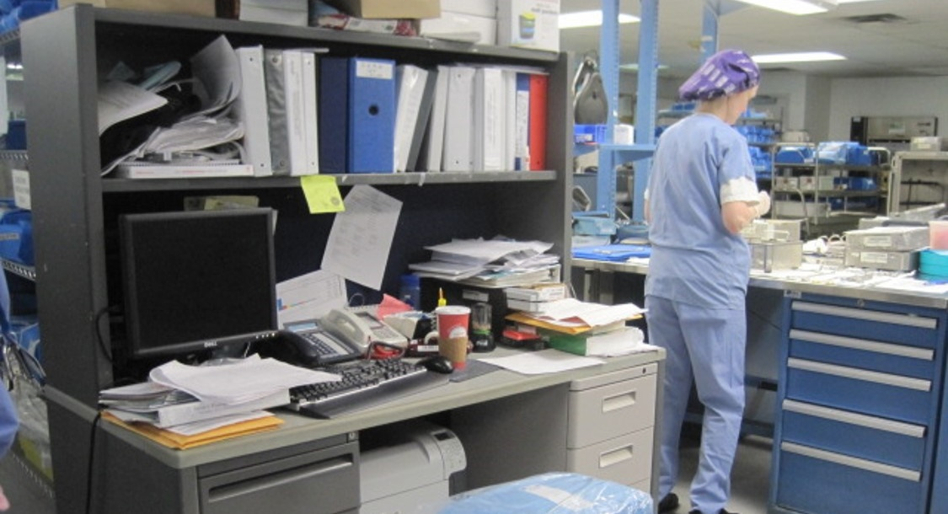
60%
Noncompliant to NPSG Standard IC.02.02.01
The organization reduces the risk of infections associated with medical equipment, devices, and supplies.
The Joint Commission 2018
Notes:
Joint commission focus between 2009-2018
On the rise, not getting better
SCRIPT NOTES:
According to the Joint Commission: 60% of facilities surveyed in 2018, were noncompliant to National Patient Safety Goals, Standard IC.02.02.01 which states “The organization reduces the risk of infections associated with medical equipment, devices, and supplies”.
The number of facilities with medical device reprocessing findings have been rising, with the number of noncompliant facilities significantly increasing between 2009-2018.
Though the Joint Commission began emphasizing sterile processing and HLD back in 2009, facilities have not continued to improve.
Additional information
None

Slide 8

Top 10 Health Technology Hazards for 2020
Surgical stapler misuse.
Point-of-care ultrasound.
Sterile processing errors in medical and dental offices.
Central venous catheter risk in at-home hemodialysis.
Unproven surgical robotic procedures.
Alarm, alert and notification overload.
Connected home healthcare security risks.
Missing implant data and MRIs.
Medication timing errors in EHRs.
Loose nuts and bolts in devices.
Notes:
ANIMATION
Click to highlight sterile processing errors
Focus on sterile processing errors
Endoscopes bumped from the top 10
SCRIPT NOTES:
Each year the ECRI Institute lists its top 10 health technology hazards. Of the many hazards listed for 2020, (Click) number three are hazards from sterile processing errors in medical and dental offices. This is the first time in many years that cleaning of endoscopes didn’t make the top 10. Do you think that’s because endoscopes no longer rate as a serious hazard in healthcare? NO, these 10 items, including sterile processing errors, are more hazardous.
So, ask yourself, what are you going to do? You need an infection control plan that addresses sterile processing.
Additional information
None

Slide 9
Infection Control Plan
Surveillance and Disease Reporting
Hand Hygiene
PPE
Injection Safety
Respiratory/ Cough Hygiene
Environmental Cleaning
Transmission based precautions
Reprocessing of Medical Devices
Notes:
SCRIPT NOTES:
Every facility needs an infection control plan. The infection control plan identifies where the risk of infection transmission happens and how the facility will reduce that risk. Though the details of an infection control plan rely on the type of procedures, patients and environment under which care is given; eight elements are common in all plans.
Surveillance and Disease Reporting
The plan should identify what is monitored, how it is monitored when, and where to report the data. It must meet local, state and federal reporting requirements as well as those required from agencies such as Centers for Medicaid & Medicare Services or CMS.
Hand Hygiene
The program should identify what is used, frequency of use and any special considerations such as artificial nails.
Personal Protective Equipment
Personal Protective Equipment, or PPE, is intended to protect the healthcare professional but consideration should be made regarding potential exposures to others when wearing or removing PPE. The plan must identify the type of PPE and when it should be used. It must comply with standard precautions. Additionally, it must meet the requirements for the equipment and chemistries use din the facility.
Injection Safety
Injection safety is more than needle sticks. Plans should consider all ways that transmission could occur between patients. There are many examples, one would be preparing injectables near contaminated supplies or materials
Respiratory/Cough Hygiene
Respiratory & Cough Hygiene is not for the facility but for the patient and visitors. The plan should identify how to find potentially ill patients and visitors and how to manage the potential spread of infection from these individuals
Environmental Cleaning
The plan should identify the cleaning process, use of disinfectants and frequency of cleaning for the entire facility. This also include the instrument reprocessing and storage areas.
Transmission based precautions
Transmission based precautions are based upon the patient population and other special considerations for the facility itself. Though is typically seen in hospitals where Tuberculosis containment may be necessary, ASCs can also have infectious agent considerations beyond the expected infection pathways.
Reprocessing Of Medical Devices
Finally, the plan must include the processes, chemistries and procedures used to process medical devices following use and in preparation for reuse.
Additional information
https://www.cdc.gov/hai/settings/outpatient/outpatient-care-guidelines.html Guide to Infection Prevention for Outpatient Settings: Minimum Expectations for Safe Care – Centers for Disease Control and Prevention (CDC)

Slide 10
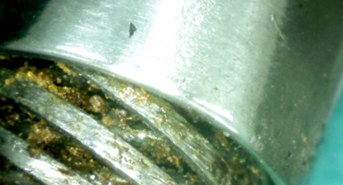
“Do not get complacent about proper sterilization.”
Dotty Bollinger RN, JD, CASC, LHRM (2012)
COO, Laser Spine Institute
Qualified infection prevention specialist
Staff education
Focus on plan basics
Regular Surveys and Audits
Notes:
ANIMATION:
Click for bullet point box
Focus on instrument reprocessing
SCRIPT NOTES:
Having a plan that includes reprocessing is not enough to be successful. As Dotty Bollinger, COO of Laser Spine Institute of Tampa Florida states facilitates must not get complacent about proper sterilization.
(Click) Facilities need a designated individual educated in infection prevention to write and manage the infection control plan. Staff must be trained and competent on all aspects of the plan where they have work. This includes all parts of medical device reprocessing.
Bollinger indicates to focus on the basics of hand washing, cleaning, and respiratory hygiene of patients, visitors and staff.
Finally, the program must be monitored with regular surveys and audits to identify noncompliance and address new infection prevention challenges. This includes all aspects including the reprocessing of medical devices.
Additional information
Printed in Becker’s Clinical Leadership and Infection Control in 2012 and again in 2020 https://www.beckersasc.com/asc-quality-infection-control/10-key-trends-in-infection-control.html

Slide 11
Infection Control Audit
Direct observation
Confirms compliance
Identifies areas for improvement
Tools to get better!
Notes:
SCRIPT NOTES:
An infection control audit is a means to confirm compliance to policies and procedures of the infection control plan through direct observation. Audits help identify areas where infection prevention practices can improve.
Audits do not point fingers or gather evidence against a person or department. THEY ARE TOOLS FOR IMPROVEMENT.
Additional information
None

Slide 12

Auditing Challenges
I have my regular job to do!
How will I find the time?
Who does the instrument reprocessing?
What am I supposed to be looking for?
Notes:
SCRIPT NOTES:
As the infection prevention specialist, among other responsibilities, you have ultimate responsibility for sterile processing practices at your facility. Surveyors expect the infection prevention specialist to know what is going on and perform regular audits of this area. Why then does an infection specialist within ASC have difficulty meeting that expectation?
Sometimes it is labeled a low priority, given all that they must accomplish.
Often, independent ASC designate a person to take on these responsibilities of infection prevention in addition to their current role. It’s difficult to find the time to audit sterile processing. ASCs that are affiliated with a hospital may rely on the hospital’s infection prevention specialist. Hospital IPs usually have a lot of other work to do, so, time becomes a constraint.
There is also a feeling of intimidation not knowing the area, processes, and staff doing the job. Instrument reprocessing may occur on-site, or a new trend is off-site. Some facilities are using a combination of both. Knowing who does what and when is challenging.
Lastly there is a lack of knowledge due to not having the training and education in the area. Not knowing what to look for is intimidating and may lead to a poorly written plan.
One way to overcome your audit challenges is visit the department or reprocessing area frequently. This is your chance to learn about the flow of the area including, appropriate dress, shoes, personal protection equipment; and determine if any processes are outsourced. Usually, an ASC is small enough that you already know the names of the workers, but it is a good idea to already know them before your visit. This will build their confidence with you and enable you to strategize your survey to make best use of your and the department’s time.
Additional information
None

Slide 13
Medical Device Reprocessing Loop
Point of Use Treatment
Transport
Transport
Storage
Decontamination
Microbiocidal Process
  Disinfection
  High Level Disinfection
  Sterilization
Notes:
SCRIPT NOTES:
This is an abbreviated flow of medical device reprocessing. Preparing devices for reprocessing starts with point-of-use treatment. This happens in the surgical suite or procedure room.
The medical devices are transported to the place where they will be decontaminated. Decontamination includes cleaning, rinsing and drying.
The devices then move to the microbiocidal process. Each device must be inspected and prepared for a microbiocidal process. Some devices will require low or intermediate disinfection. Others may need high level disinfection. Still others may require sterilization. The microbiocidal process required for each device is dependent on the type of device, how it is used and the manufacturer's written instruction for use also called IFU.
The disinfected or sterilized devices are then stored until needed for the next case where they are transported to the operating room or procedure room.
Reprocessing medical devices is a complex process. Each step above can have hundreds of steps, processes and equipment to consider. Some may be done in house while others may be transported to a reprocessing center. We can’t cover everything today, but we’ll hit the highlights to give you an idea of things to look for.
Additional information
None

Slide 14
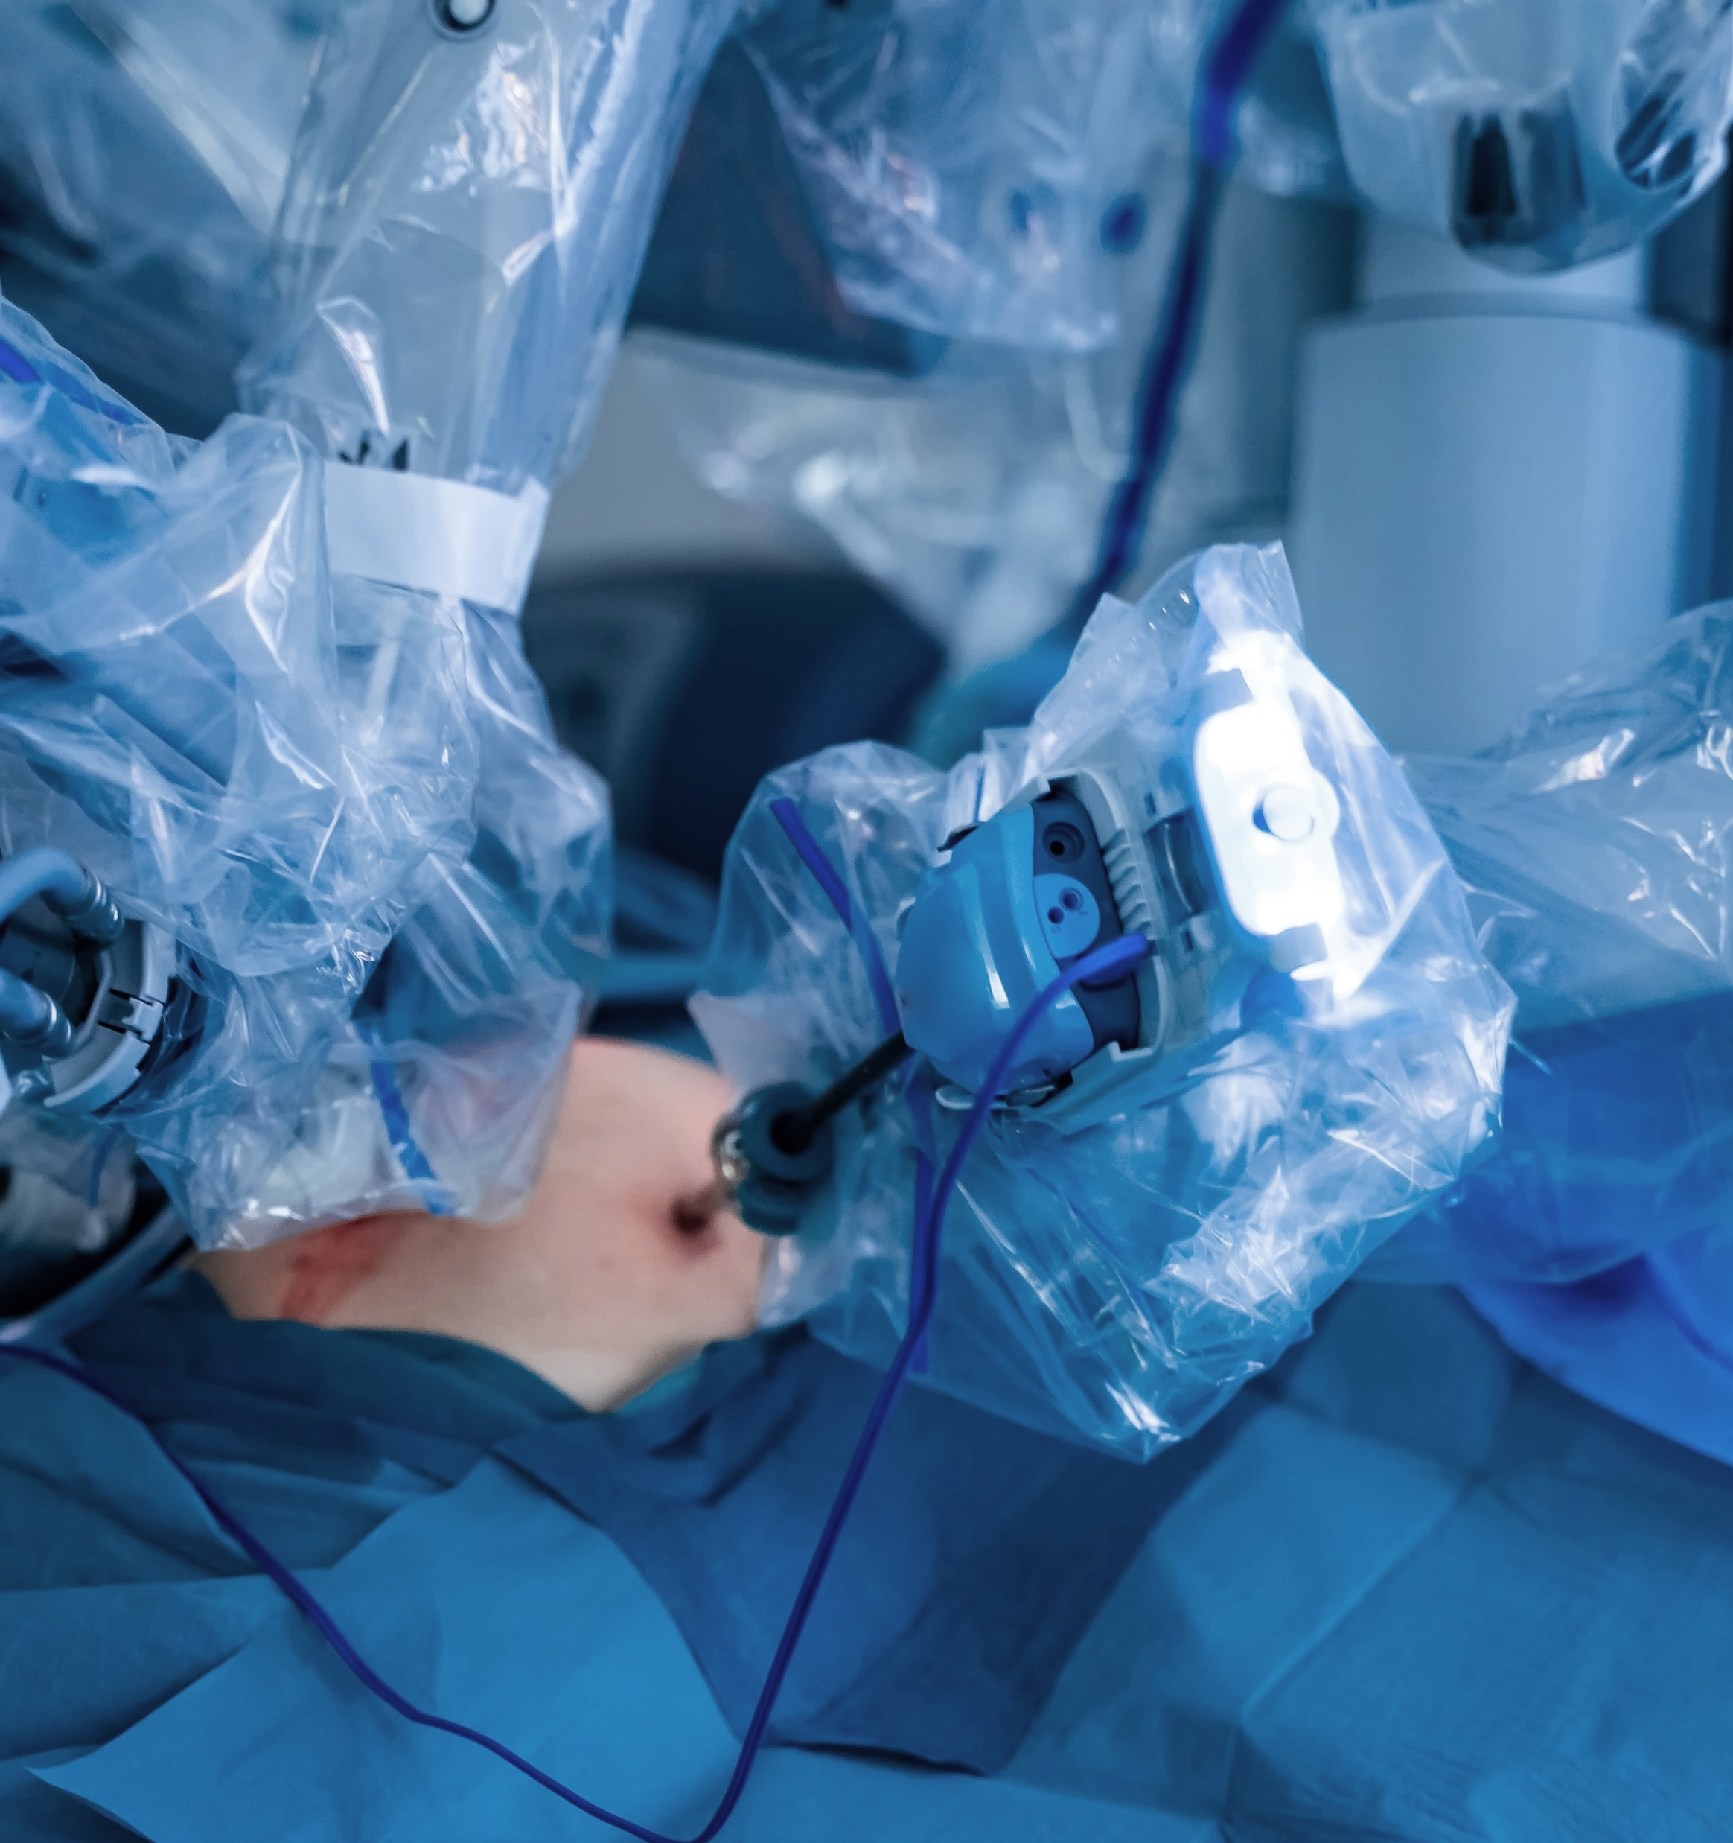

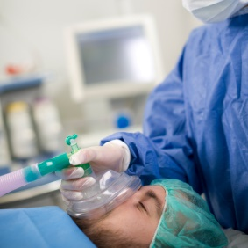
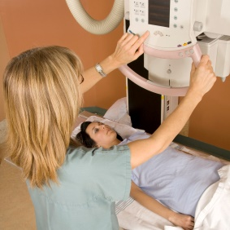
Point-of-Use and Transport
Notes:
Transition slide
SCRIPT NOTES:
The first step in the reprocessing loop is the point at which it is used. Medical devices must be prepared and transported to the decontamination area.
Additional information
None

Slide 15
Point of Use Treatment
During Procedure
Remove gross soil
Keep Moist
No saline
Post Procedure
Remove gross soil
Discard waste
Disassemble per IFU
Keep moist for transport
Notes:
SCRIPT NOTES:
Standards, professional organization’s guidance, and device manufacturer IFUs require proper treatment of instrumentation during and after use.
Per the Association of periOperative Registered Nurses or AORN, instruments need to be cleaned to remove gross soil after each use and kept moist during the procedure. This applies to lumened instruments too. It’s important not to use saline. Saline can damage instrumentation increasing your device repair and replacement costs.
Post procedure, technicians and nurses must ensure gross soil is removed. Wastes and disposables must be disposed of in the room. All instruments need to be opened and, if specified in the IFU, disassembled.
Lastly, devices must be kept moist as they are transported to the decontamination area. This includes all exterior surfaces, lumens, and hinges. Using a towel moistened with sterile water, not saline, or a point–of-use treatment product, such as a transport gel, helps to keep devices moist during transport.
Additional information
None

Slide 16
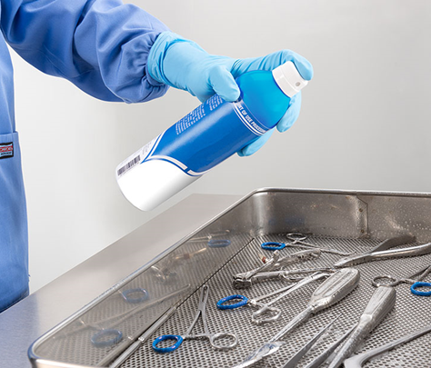
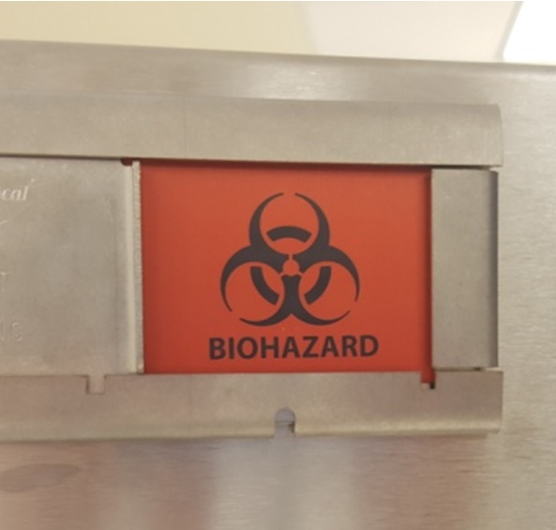
Soiled Transport – O.R.
Puncture-proof container with lid or case cart
Instruments kept moist
Labeled BIOHAZARD
As soon after procedure as possible
Notes:
SCRIPT NOTES:
Often, I see non-compliance to soiled transport standards. Staff assume that the short distance between the procedure room and decontamination area coupled with immediate processing of devices negates the need to follow these standards. This is not true nor do the surveyors view the standard that way. The OSHA regulation on contaminated instrument transport doesn’t have distance minimums. No matter the distance, standards must be followed.
Devices are placed in a puncture proof container, moistened per AAMI standards, with a lid. They may also be transported within closed case carts. Containers with lids, and inside case carts, help to prevent contamination of other areas during transportation to the reprocessing area and help to keep soils moist on devices while waiting for decontamination to start. Dried soils are difficult to remove and may lead to residual soil after cleaning which can interfere with disinfection and sterilization creating an opportunity for cross contamination.
Each container must be labeled with a biohazard label or sign. Soiled instrument should be transported immediately after the procedure.
As soiled devices wait to be decontaminated, the groundwork for a biofilm begins. It takes as little as 20 minutes for a microscopic biofilm to form. The longer it waits the more time available to create the biofilm. The more biofilm, the harder it is to remove during cleaning.
Additional information:
Paragraph 29 CFR 1910.1030(d)(2)(viii) of the Blood Borne Pathogen Regulation https://www.osha.gov/laws-regs/regulations/standardnumber/1910/1910.1030
Letter of medical device transport to VA from OHSHA: https://www.osha.gov/laws-regs/standardinterpretations/2013-01-31-2

Slide 17
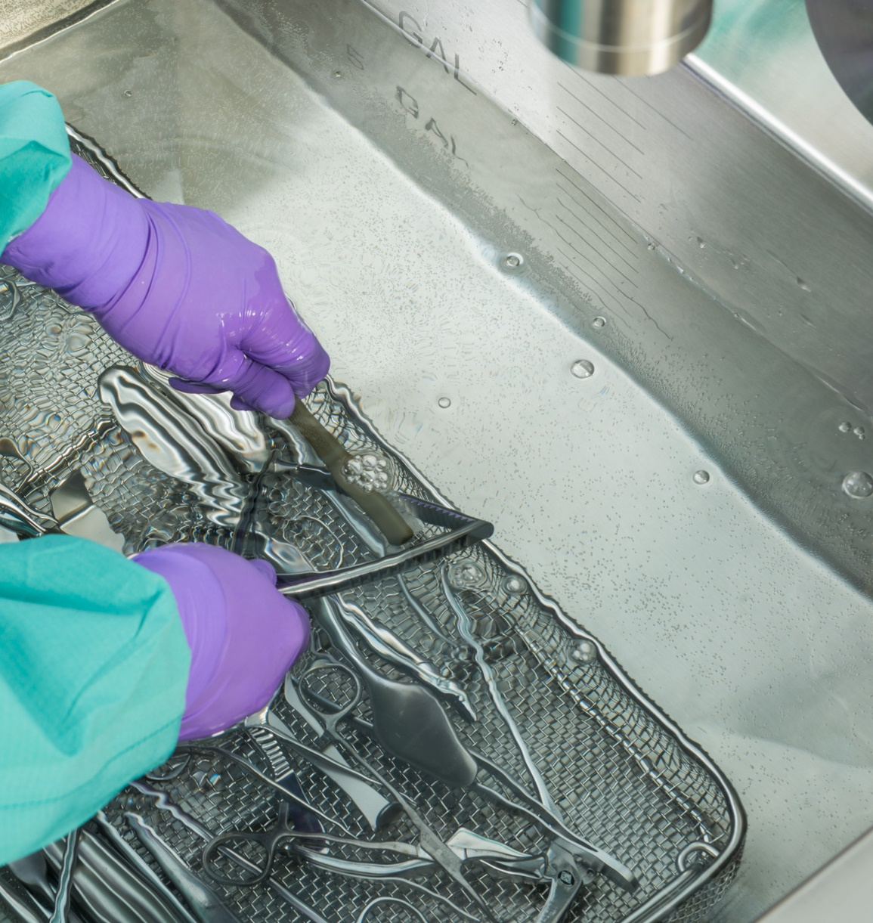
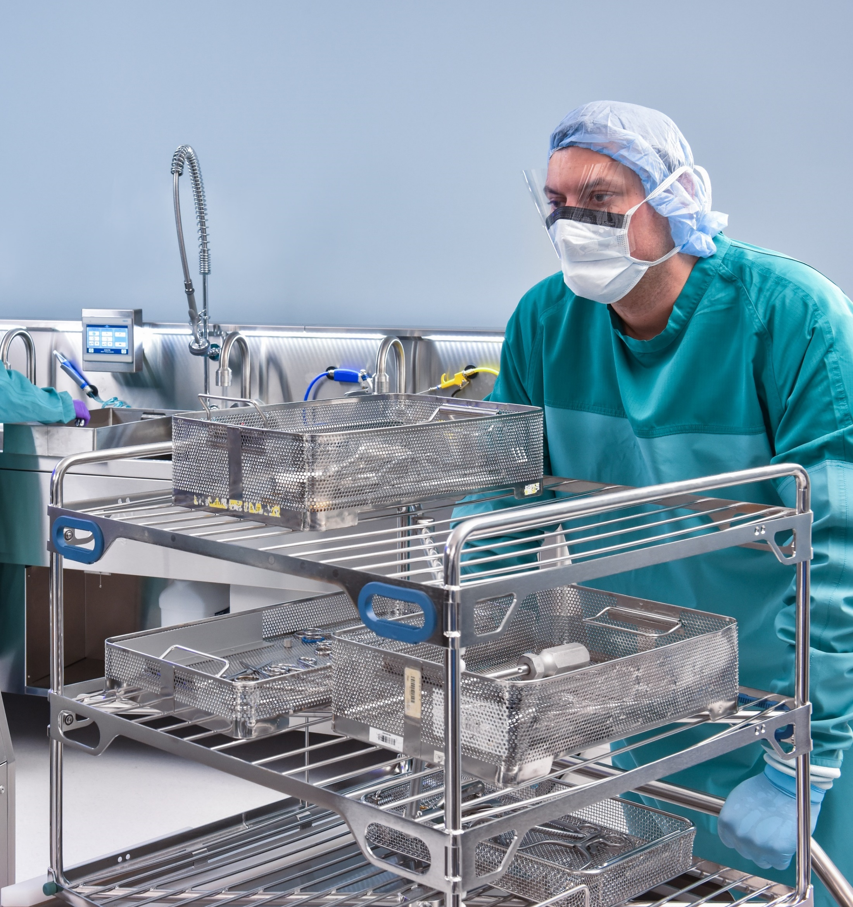
Decontamination
Notes:
Transition slide
SCRIPT NOTES:
Decontamination removes soil from the devices. It is the most important part of the reprocessing loop. Residual soil interferes with disinfection and sterilization. It has also been associated with infection and diseases such as TASS (toxic anterior segment syndrome.)
Additional information
None

Slide 18
Reprocessing Workflow
Rinse, Clean, Rinse
HLD
or
Sterilized
Thermal or Chemical Disinfection
Soiled
Contaminated
Safe to Handle
Notes:
SCRIPT NOTES:
Workflow should travel along a unidirectional path from contaminated to clean to thermal or chemical disinfection and lastly high-level disinfection or sterilization.
In the decontamination area, devices are received. A cold-water rinse followed by thorough cleaning removing soils. Devices are rinsed with treated water and undergo thermal disinfection. After which, they are ready to move to assembly and packaging, where they undergo high-level disinfection or sterilization.
It’s important to note that not all devices can be thermally or chemically disinfected. Those devices are clean but still are contaminated and not safe to handle until further microbiocidal processes have been completed.
Additional information
None

Slide 19
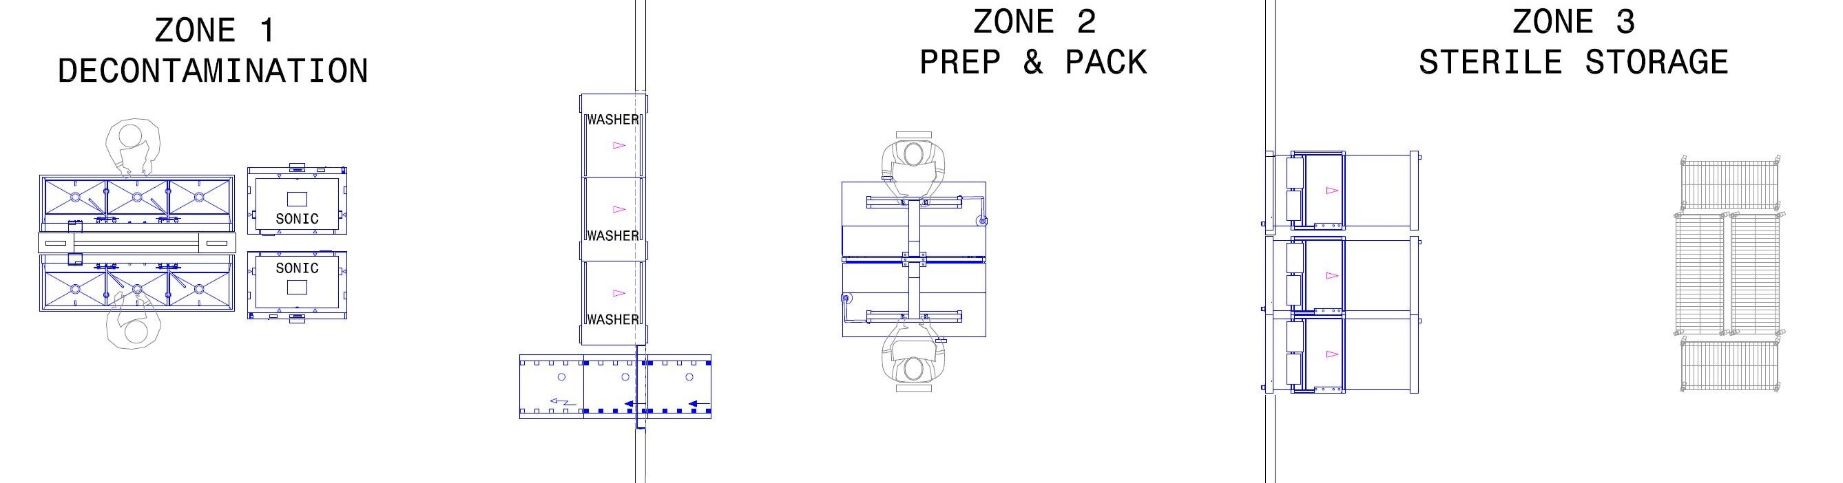
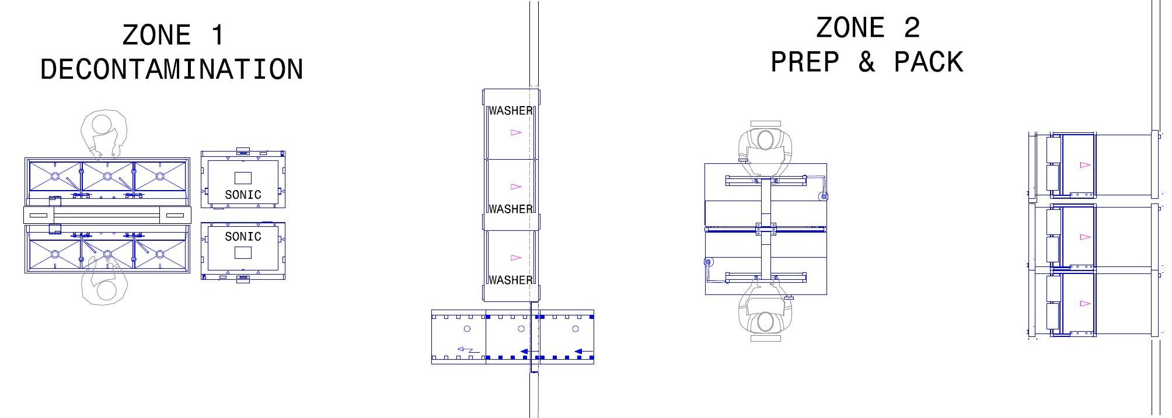
3-Zone and 2-Zone Workflow
Notes:
SCRIPT NOTES:
In an ideal world with lots of space, instrument reprocessing would be divided into three rooms or zones. The first zone would be the decontamination room. This room receives the contaminated devices, case carts and any other medical devices that require cleaning.
The clean and dry devices would pass through a wall either by equipment with two doors or through a pass through to the prep and pack or assembly area. The prepared items would then be sterilized in a double door sterilizer that opens into the third room sterile storage.
The most common sterile processing department configuration is 2 zone. Decontamination is zone one, but the sterilization occurs in the same room as assembly.
Additional information
None

Slide 20

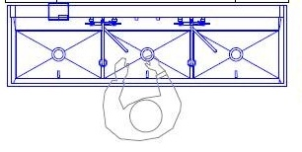
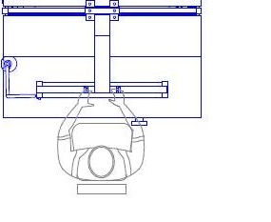
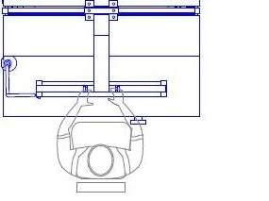
Single Zone Reprocessing
Cleaning & Rinsing
Assembly
4 Feet
Things to Check
Is workflow from dirty to clean
Are physical distancing or barriers in place
4 Feet
Cleaning & Rinsing
Assembly
Notes:
ANIMATION:
Click for pos-it note to fade in
SCRIPT NOTES:
In some Ambulatory Surgery & Office-based Surgical Facilities, separate rooms are not possible. In these situations, workflow is combined with distancing or physical barriers to prevent cross contamination between dirty and clean activities
The decontamination sink should be separated from the clean work area by a 4-foot distance starting at the edge of the closest sink to the clean work area.
If a screen is used, it should extend a minimum of 4 feet above the sink rim and lay flush with the work surface.
Please remember decontamination should NOT take place at the same time you are assembling and packaging, due to aerosolization.
Things to check when auditing include the direction of work from dirty to clean and the barrier, whether physical or by distance, is sufficient.
Additional information
American Society for Healthcare Engineering; The Facility Guidelines Institute. (2018) Guidelines For Design and Construction of Outpatient Facilities, Chicago, IL: American Society of Healthcare Engineering

Slide 21
Decontamination Delay
Dried Soil
Biofilm Formation
Damage to Passivation Layer
Damage to coated surfaces
Delays in processing
Things to Check
Are there delays
Enough reprocessing staff
Are IFUs followed for delays
Notes:
ANIMATION:
Click for post-it note to fade in
SCRIPT NOTES:
It is critical that delays in processing not be the norm, this process can have costly consequences.
Soils drying on medical devices make them harder to remove in the decontamination area. The resulting residual soils can interfere with disinfection and sterilization processes allowing cross contamination when used.
Residual soils can promote the development of biofilm. Biofilm is a protected colony of bacteria which resist cleaning, disinfection and sterilization processes. Once established as a mature biofilm, it is nearly impossible to get rid of. Not only can this cause cross contamination it can result in the early disposal of expensive medical devices.
Dried soils may require longer soaking and scrubbing to remove them. This may lead to damage of the passivation layer of stainless-steel surgical instruments or coated surfaces like those found on cauterizing devices
Finally, delays in reprocessing increases the processing time as additional soaks and cleaning steps may be required per the medical device manufacturer's IFU. This adds additional strain to device processing systems already at capacity.
Things to check include:
the time between case end and the start of processing
If staffing accounts for high volume times
Confirm that IFU are followed when a delay occurs
Additional information
None

Slide 22
Manual Cleaning & Decontamination Steps
Soak
Treated Water Rinse
Brush & Flush
Cold Water Rinse
Notes:
SCRIPT NOTES:
Soiled devices have been kept moist prior to arriving in the decontamination area. Once there, they must first be rinsed with cold water. This removes visible debris and pretreatment products.
The devices are then soaked. Not every manufacture’s written IFU states that soaking is required so it is important to read them.
The devices then move to the sink filled with cleaning solution. Surfaces and lumens are brushed and flushed to remove soils.
The last step is to rinse all surfaces and flush lumens with fresh, clean, treated water.
Although a 3-sink system is preferred a 2-sink configuration can work.
Additional information
None

Slide 23
Manual Cleaning & Decontamination
IFU
Water
Brushes
Chemistry
Temp
Clean Device
Notes:
SCRIPT NOTES:
When manually Cleaning and decontaminating instruments you must always follow the manufacturer’s written IFU. This same concept is carried over to the use of cleaning chemistries. Always dilute the water per the IFU, paying close attention the temperature recommended in the IFU.
Characteristics of a great enzymatic/detergent solution include being non-abrasive and non-foaming. Remember that an enzyme is not a disinfectant, it only breaks down the amount of bioburden on the instruments. Above all it must be formulated for surgical instruments.
What is in your water?? Water Quality Matters, Final Rinse must be treated water.
Additional information
None

Slide 24
Manual Cleaning & Decontamination
IFU
IFU
Device
Cleaning Chemistry
Cleaning Brushes
Necessary Accessories
Water
Brushes
Chemistry
Temp
Clean Device
Notes:
ANIMATION
Automatic animation. Do nothing
SCRIPT NOTES:
When manually Cleaning and decontaminating instruments you must always follow the manufacturer’s written IFU. This same concept is carried over to the use of cleaning chemistries, brushes and any necessary accessories.
Additional information
None

Slide 25
Manual Cleaning & Decontamination
IFU
Chemistry
Correct Dilution
Non-abrasive
Non-foaming
Formulated for medical devices
Water
Brushes
Chemistry
Temp
Clean Device
Notes:
ANIMATION
Automatic animation. Do nothing
SCRIPT NOTES:
Always dilute with water per the IFU. Too little and it won’t clean well. Too much and it may not be able to completely rinse off. Either situation can result in harmful residuals on the devices.
Cleaning chemistry should be non-abrasive and non-foaming. Abrasive chemistries can harm surface finished damaging instrument. Foaming cleaning chemistries make it hard to see in the sink. Staff may be injured when handling instruments that can not be easily seen.
Remember that an enzyme is not a disinfectant, it only breaks down the amount of bioburden on the instruments. Above all it must be formulated for surgical instruments..
Additional information
None

Slide 26
Manual Cleaning & Decontamination
IFU
Temp
Correct for chemistry
Maintained
Water
Brushes
Chemistry
Temp
Clean Device
Notes:
ANIMATION
Automatic animation. Do nothing
SCRIPT NOTES:
Pay close attention to the temperature recommended in the cleaning chemistry IFU. Many cleaning chemistries rely on enzymes to assist in soil removal. Enzymes work best at specific temperatures. Always be sure that the sink cleaning chemistry is at the right temperature for it to work best.
It is also important to maintain that temperature for the entire time that the cleaning solution is used.
Additional information
None

Slide 27
Manual Cleaning & Decontamination
IFU
Brushes
Right type
Right size
Regularly Disinfected
Do not reuse single use
Water
Brushes
Chemistry
Temp
Clean Device
Notes:
ANIMATION
Automatic animation. Do nothing
SCRIPT NOTES:
Brushes are critical tools for removal of soil and the beginning phases of biofilms. Many brush designs are available dependent upon the cleaning need. Using the wrong brush type or brush material can result in poor cleaning and even damage instrumentation. I can’t tell you how many times a metal brush was used on soft metal ruining the instrument.
Brushes used to clean lumens are specific for the size of the lumen. A brush that is too small or too big will not effectively remove the soil. A brush that is too big can damage the device.
Reusable brushes must be regularly cleaned and disinfected per the manufacturer's written IFU to prevent the formation of biofilm.
Do not reuse a single use brush.
Additional information
What constitutes a single use?
The facility must define what constitutes a single use. They should rely on the brush manufacturer's written IFU and facility risk assessment to determine what a use means.

Slide 28
Manual Cleaning & Decontamination
IFU
Water
Mineral and metal ion
Deionized / reverse osmosis rinses
Bacteria
Endotoxin
Water
Brushes
Chemistry
Temp
Clean Device
Notes:
ANIMATION
Automatic animation. Do nothing
SCRIPT NOTES:
What is in your water? A lot! Water contains minerals, metal ions and bacteria. When mineral and metal ions are high, such as in hard water, they can deposit on device surfaces which builds up over time. These deposits can damage devices and protect bacteria from disinfection and sterilization processes.
Some cleaning chemistries contain components that help prevent ,minerals and ions from depositing on devices. This component is called a chelating agent. However, the formulation of those chemistries is important. Without enough of the, chelating sequestering components, a cleaning chemistry can be overwhelmed by hard water resulting in mineral deposits.
Though cleaning chemistries may have sequestering agents, the rinse water does not. For this reason, rinse water should be treated to remove minerals and ions. Facilities rely on deionized or reverse osmosis water supplies for the final rinse.
Water, even treated water, contains low levels of bacteria. These are typically bacteria associated with biofilms that form within the water delivery systems. Its important to monitor the level of bacteria in your water at all facility dispense points to ensure it stays within the AAMI recommendations. This includes treated water.
Where there are bacterium and organic soils, there can be endotoxins. Water should also be evaluated for unacceptable levels of endotoxin.
Additional information
None

Slide 29
Manual Cleaning & Decontamination
IFU
Things to Check
Things to Check
Water
Things to Check
Brushes
Make IFU available
Staff educated and competent
Right cleaning tools available
Confirm dilution rates and temps
Confirm chemistry is right for the devices and water quality of the facility
Bacterial and Endotoxin water testing
Ensure DI or RO water is used for rinses
Chemistry
Temp
Clean Device
Notes:
ANIMATION
3 post-it notes click for each to appear
SCRIPT NOTES:
(Click) Make sure that staff have and follow all manufacturers’ written IFU including the cleaning chemistries cleaning tools and accessories, and the devices. Staff should be educated in the process and competencies established. Be sure that staff have the right tools and accessories they need to do the job right.
(Click) Confirm that the sink is filled with the right quantity of water for the cleaning chemistry dispensed. It can be helpful to add a water level marker to the sink and use automated chemistry dispensers. Facilities may also consider performing water testing to confirm that the chemistry used is sufficient for their water supply. Often, manufacturers of medical grade cleaning chemistries offer water testing services.
(Click) Speaking of water, be sure to set up a regular water testing program that includes bacteria and endotoxins identifies in AAMI water quality guide. Lastly, confirm that all rinses are using DI or RO water and not tap water.
Additional information
None

Slide 30
Automated Cleaning
Soak
Automated Cleaning
Manual Cleaning
Cold Water Rinse
Notes:
SCRIPT NOTES:
Due to the increase of orthopedic procedures in ASCs, we see an increase in automated cleaning equipment as an essential part of their decontamination process.
Automated cleaning follows the same path as manual cleaning. Soiled items are rinsed with cold water. This is followed by soaking. Depending on the device manufacturer's IFU, manual cleaning may be necessary prior to automated cleaning.
Additional information
None

Slide 31

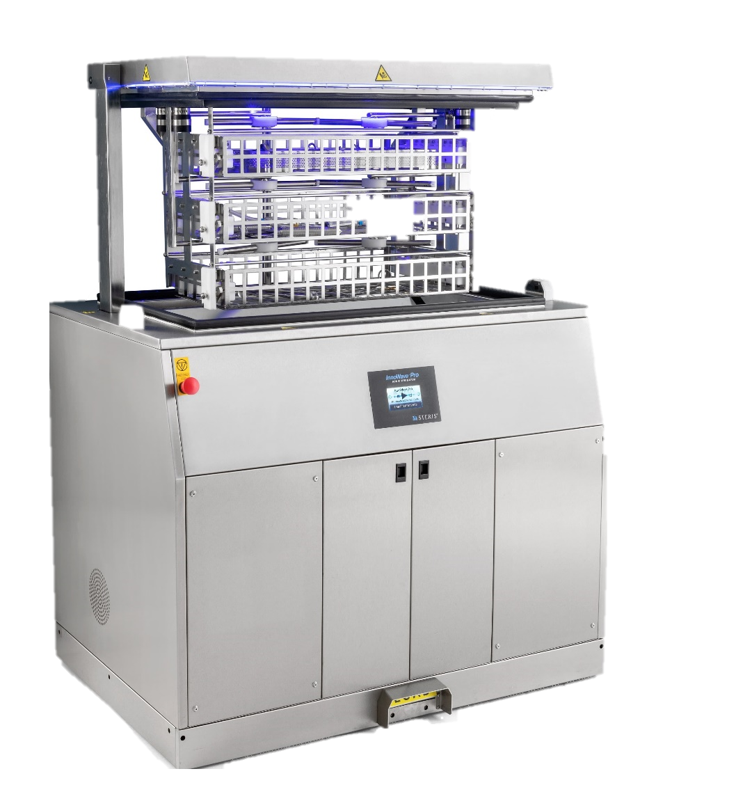
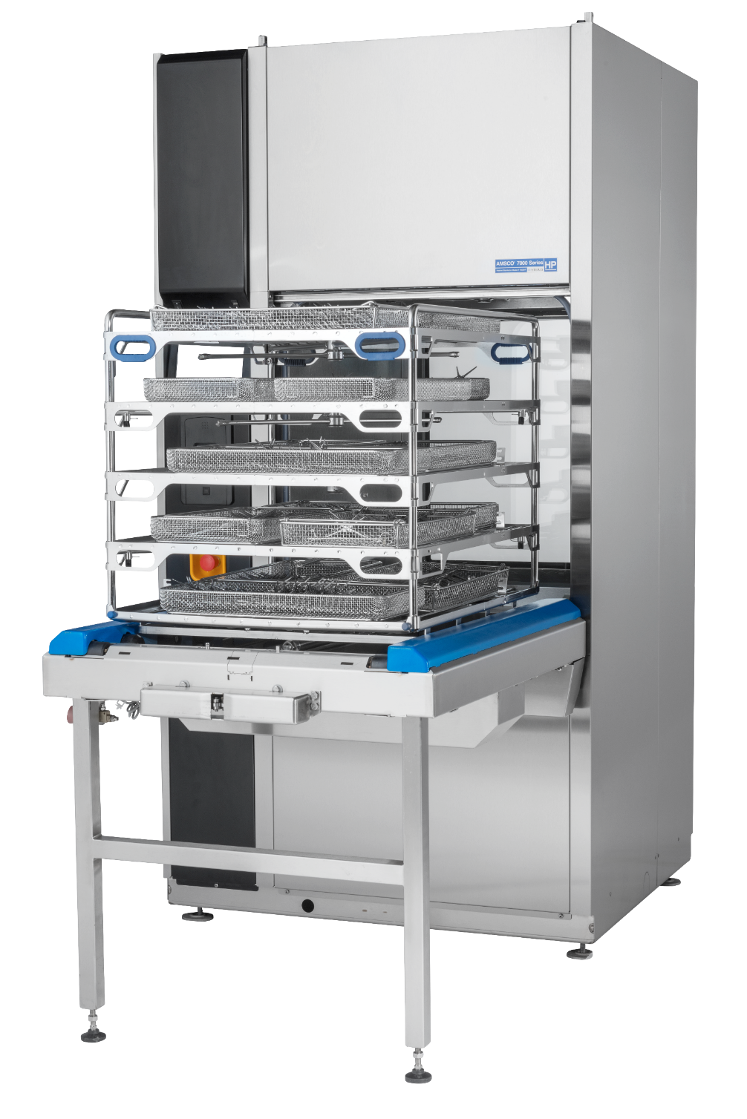

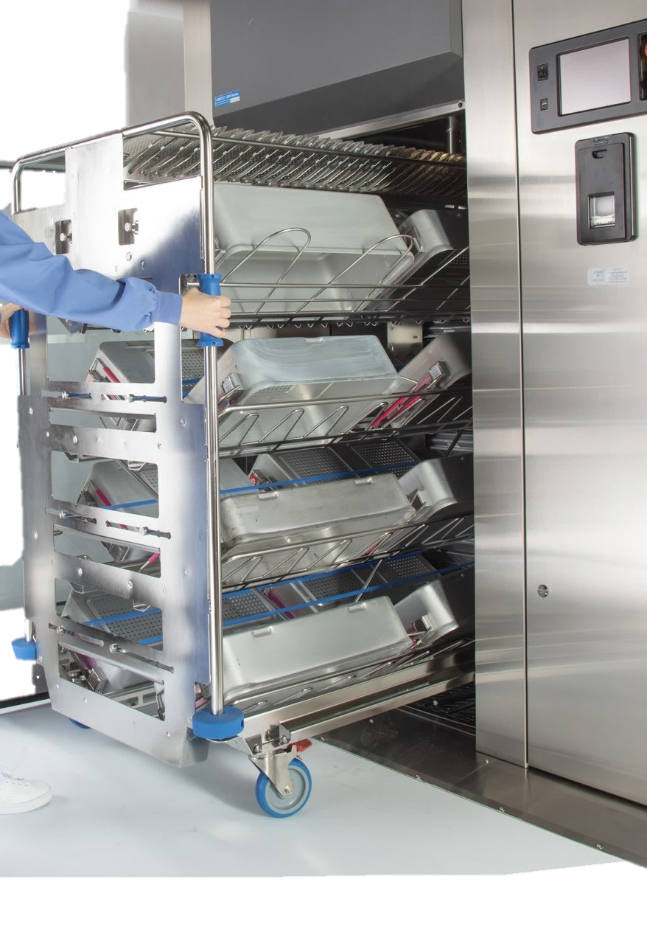
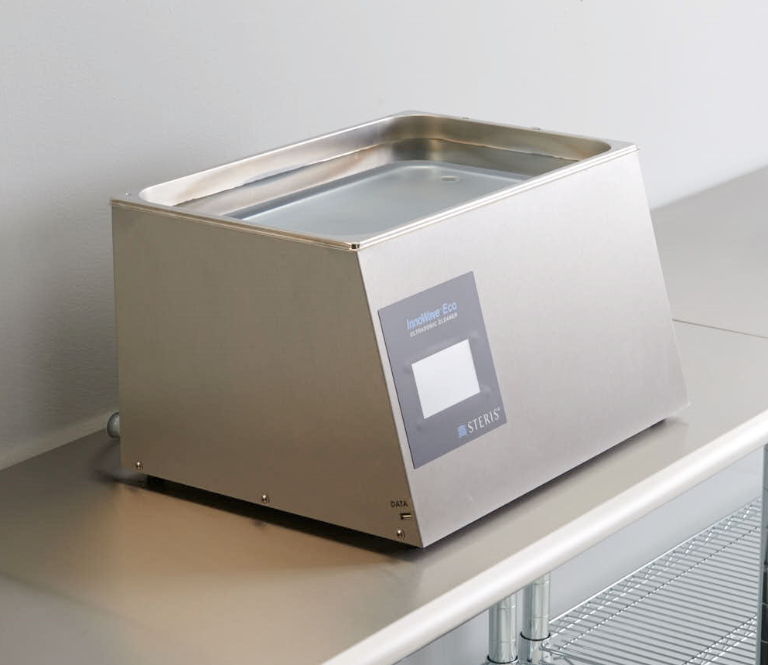
Automated Cleaning
Washers
Ultrasonics
Notes:
ANIMATION
Click for washer thermometer
Click for ultrasonic thermometers
SCRIPT NOTES:
Automated cleaning equipment include ultrasonic cleaners of all sizes, instrument washers, and cart washers. Often, cart washers and instrument washers will be used to clean container systems, filter retainers and other container accessories prior to use.
(Click) Thermal disinfection is available in most washers. Thermal disinfection uses heated water to kill microorganisms found on and in the devices. (Click) Ultrasonic cleaners sometimes have this feature. However, the majority do not.
Additional information:
None

Slide 32
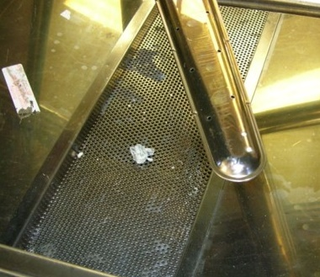
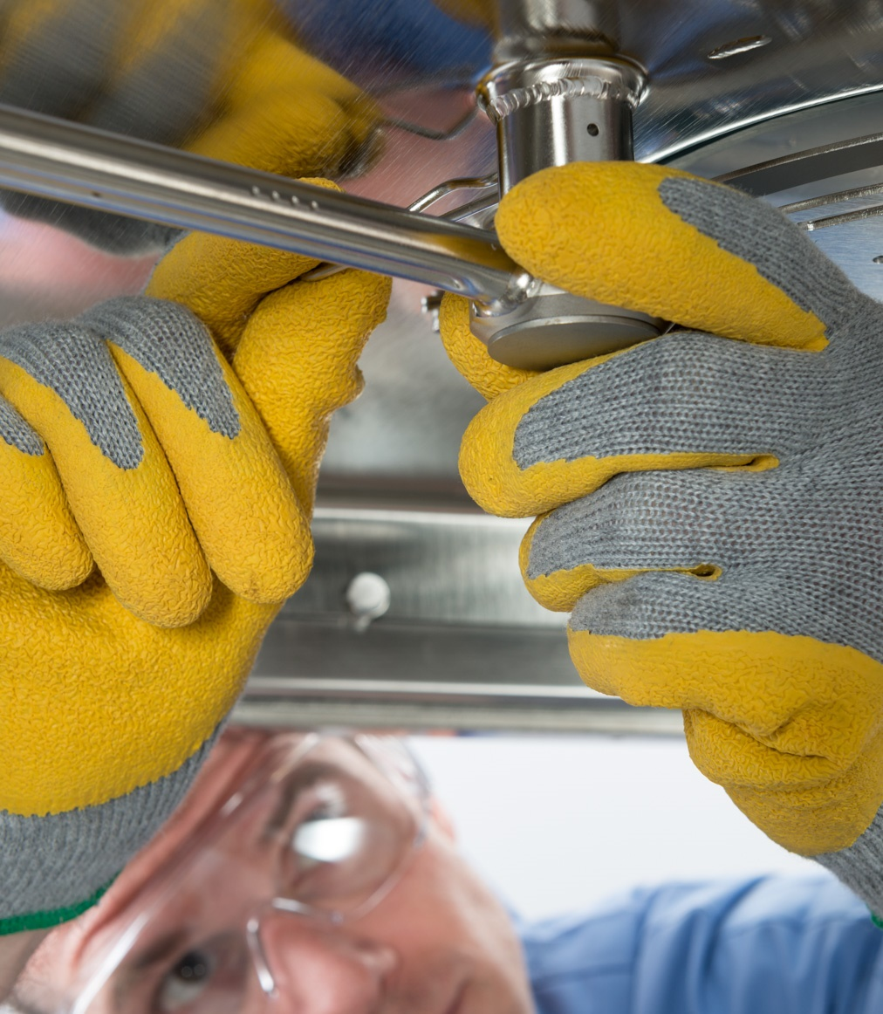
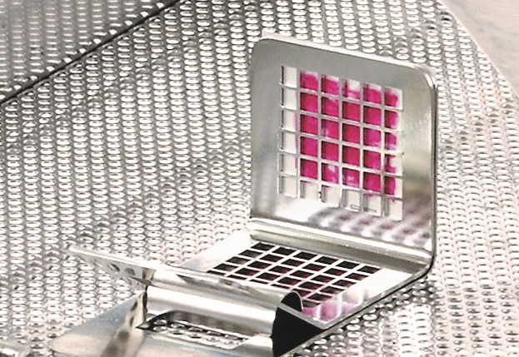
Automated Cleaning Equipment
Water & cleaning chemistry
Dilution rates
Lumen flow & adapters
Daily performance testing
Cleaning & disinfection schedule
Preventative maintenance
Things to Check
Confirm the right cleaning chemistry
Check dilution rates
Flow connectors used
Verify performance testing
Confirm disinfection schedule
Review PM records
Notes:
ANIMATION:
Click for pos-it note to fade in
SCRIPT NOTES:
Washers and Ultrasonic cleaners have the same water needs as manual cleaning. Rinse water must be deionized or reverse osmosis.
The cleaning chemistries are different from that used at the sink. They are also different between washers and ultrasonic cleaners. Ultrasonic cleaners need chemistries that work with cavitation and not against it. Using the wrong cleaning chemistry could impede the cleaning process.
Dilution rates will be different between equipment depending on the cleaning chemistry’s concentration and the total volume of water used in the cleaning phase. Always confirm the proper dilution rate.
Devices with lumens should be flowed with cleaning solution. Washers and ultrasonic cleaners use adapters to flow fluids through lumens.
Daily performance testing is required for all automated cleaning equipment and records of the testing kept.
Schedule regular cleaning and disinfection according to manufacturer’s written instruction. Instructions vary widely between equipment models. Never assume that the schedule for one piece of equipment meets the recommendations of another similar piece. Cleaning equipment must be regularly disinfected to prevent biofilm from forming. The frequency and chemistry to use will be identified in the manufacturer's written IFU.
The equipment should be serviced routinely by qualified service technicians and depending on the requirements of the accrediting agency all preventative maintenance records need to be kept.
(Click) When auditing this area, confirm that the hospital right cleaning chemistry is used and the dilution rates are appropriate for the application.
Confirm that flow connectors or adapters are used on lumen devices,
Verify that performance testing is occurring daily on each piece of cleaning equipment.
Inspect the equipment for cleanliness and review the disinfection history to ensure that the schedule is kept.
Lastly, look over the preventative maintenance records. Are they happening as recommended in the written manufacturers IFU? Are all items completed on time?
Additional information:
None

Slide 33

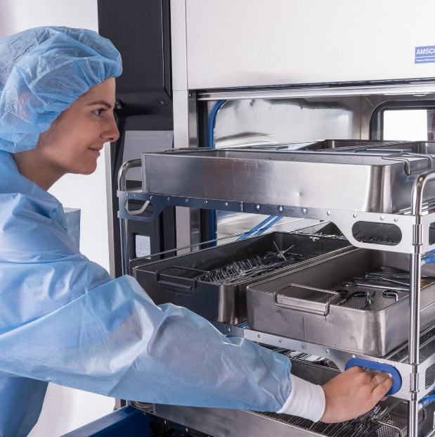
Drying
Manual Cleaning
Air Purge
Drying Cabinet
Automated Cleaning
Notes:
SCRIPT NOTES:
After items have been manually clean and rinsed, water is purged from the device. Compressed instrument air is used. It is important to use medical grade air since it is filtered to remove impurities and oils that would otherwise contaminate the device. The devices are typically passed to the clean side through a closable window.
Though they have been purged, the devices are still wet. The drying process is continued by either allowing them to air dry in a clean place or by placing the devices in a drying cabinet.
Items that have been sonicated are typically wet at the end of the process. They would follow the same drying path as manually cleaned items. Some ultrasonic cleaners and most washers will have a drying phase. After drying is complete, they are passed to the clean side. Items that were sonicated may continue to automated washing or travel through the pass thru. Washers typically have two doors. One for loading on the dirty side and another for unloading on the clean side. Instruments with residual moisture after the drying phase would be dried on the clean side using air purges and drying cabinets.
Additional information:
None

Slide 34
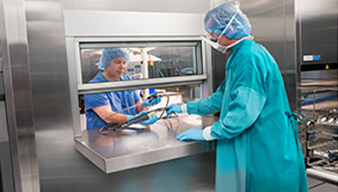
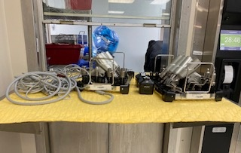
Pass Through
Maintain positive pressure flow
Drying station
Cleaning & disinfection schedule
Preventative maintenance
Things to Check
Observe that the window is kept close
Regularly replace absorbent material
Check completion of cleaning and disinfection
Review PM records
Notes:
ANIMATION:
Click for post-it
SCRIPT NOTES:
Pass-through window maintains the pressure difference between the clean and dirty sides. Air on the clean side is set at a higher pressure than that on the dirty side. This causes air to flow from the clean side to the dirty side preventing microbes from escaping. Any time a door or window is open between them, air pressure could drop on the clean side allowing microbe enriched air from the dirty side to invade the clean items. Pass through windows help to maintain that positive pressure by remaining closed when not actively transferring items.
Some facilities opt to use the clean side shelf of the pass-thru window to air dry devices. This not advisable since this may lead to device damage as devices are placed one upon another. It can also make a dry instrument wet as the new device drips on it.
Pass thru windows must be regularly cleaned and disinfected. Remember that many manually cleaned devices that are passed through to the clean side are not disinfected only clean. Residual water from wet devices can become breeding grounds for microorganisms.
Preventative maintenance is also important for the pass thru window. Surfaces, seals and any working components may require repair, replacement or other preventative service.
(Click) Take time to watch the use of the pass-through window. Staff should always close it after transfer. Staff should not use it to hold conversations with the other side. Observe the absorbent materials. Do they need to be changed? When was the last time they were changed?
Review the cleaning and disinfection practices. Is it being completed as recommended by the manufacturer's written IFU?
Examine the preventative maintenance records. Do they meet the manufacturer's written IFU and have they been completed on time?
Additional information:
None

Slide 35
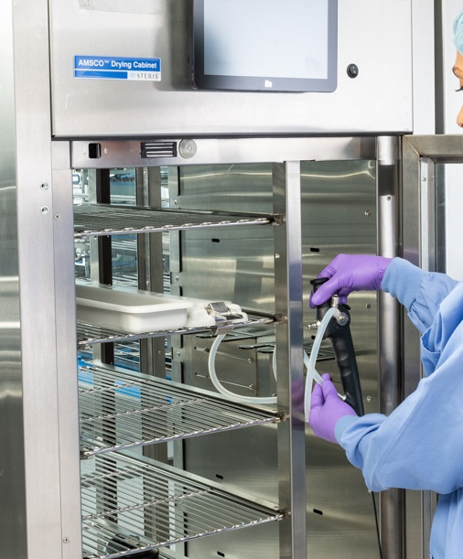
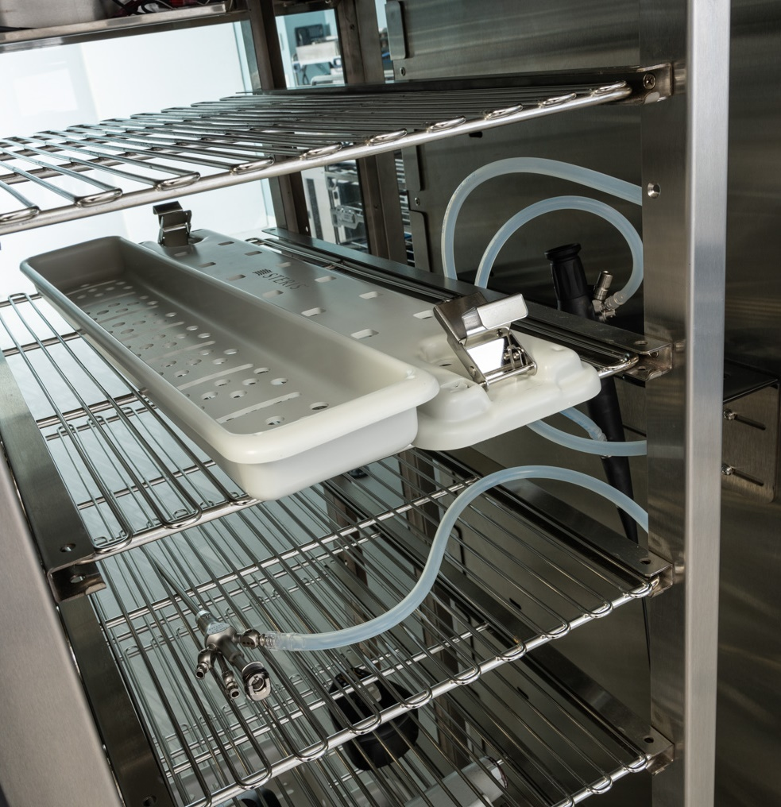
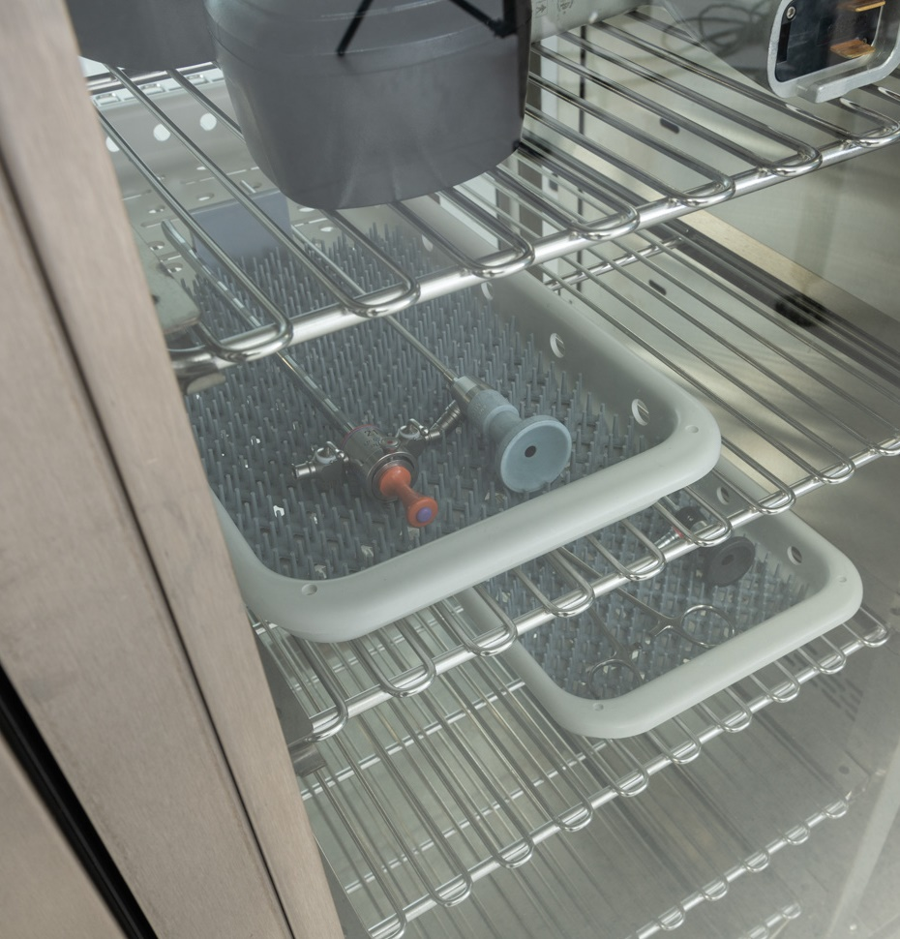
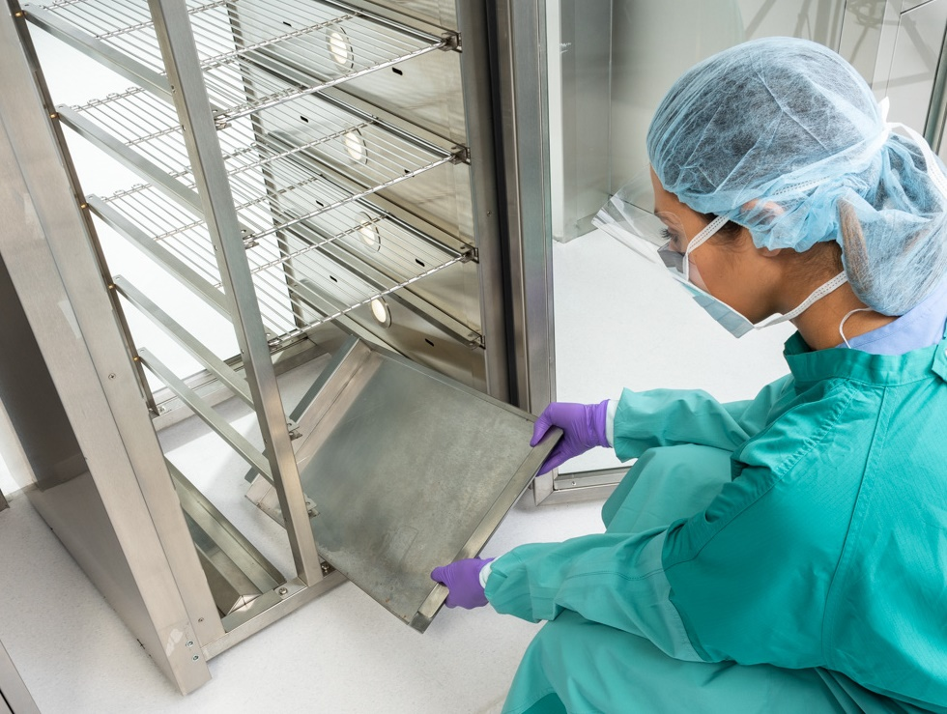
Drying Cabinets
Temperature control
HEPA filter air
Lumen adapters / connectors
Cleaning & disinfection schedule
Preventative maintenance
Things to Check
Check temperature requirements and monitoring log
Check adaptors and connectors
Review filter & PM records
Notes:
ANIMATION
Click to see pos-it note
SCRIPT NOTES:
Typically, drying cabinets use low temperature heated air to help promote drying. Some have lumen tubing hookups to flow air through lumens and assist in drying. HEPA Filters remove particulates from the air that may carry microorganisms. Some cabinets use hepa filtered air while others do not.
Drying cabinets may also be designed to flow air through lumens. Connectors or adapters are necessary to connect the lumens to ports within the cabinet. Cabinets must be regularly cleaned and disinfected. Connectors, adapters and tubing must also be cleaned and disinfected regularly. The schedule is based upon the recommendations found in the manufacturers' written IFU.
Just like other equipment, drying cabinets with fans, filters or other moving parts require filter changes and may need preventative maintenance.
(Click) When auditing this area, check the temperature requirements and monitoring log. Confirm that cabinets, adapters and connectors are cleaned and disinfected as directed by the manufacturer's written IFU. Review the filter change logs and PM records. Have they been completed per the manufacturer's written IFU?
Additional information:
None

Slide 36
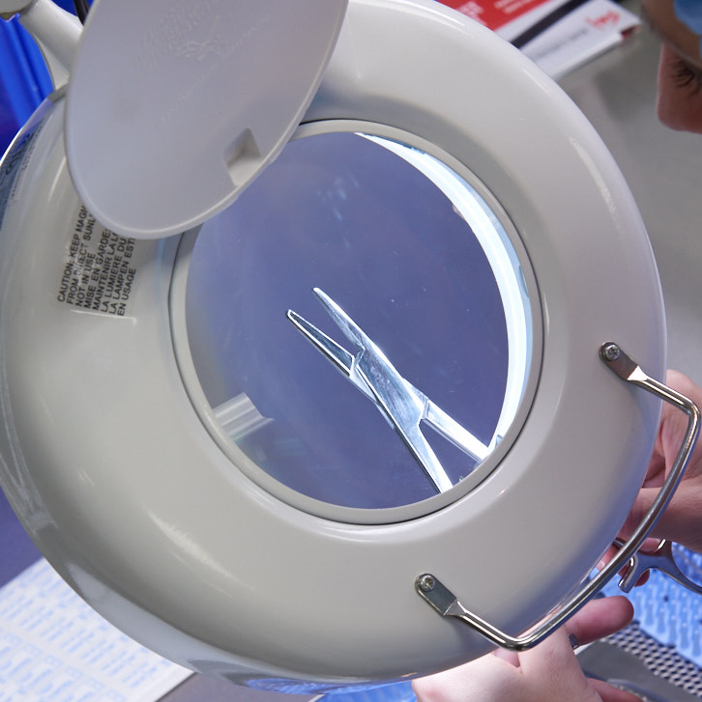
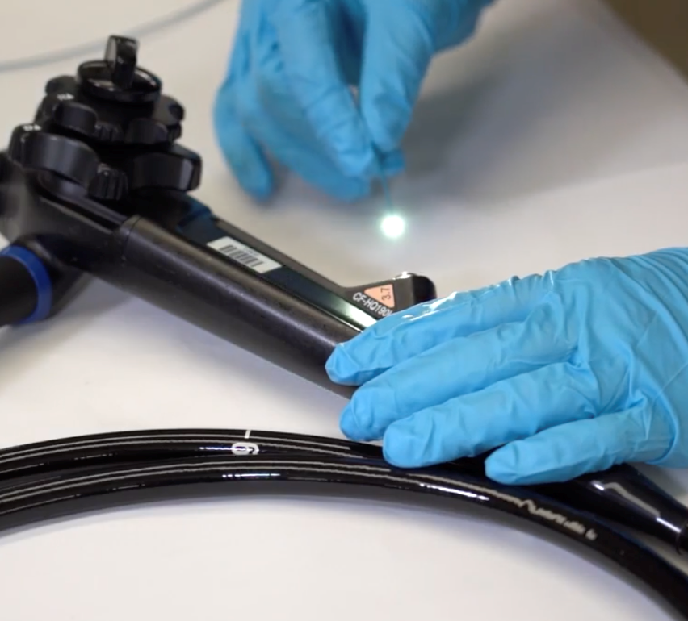
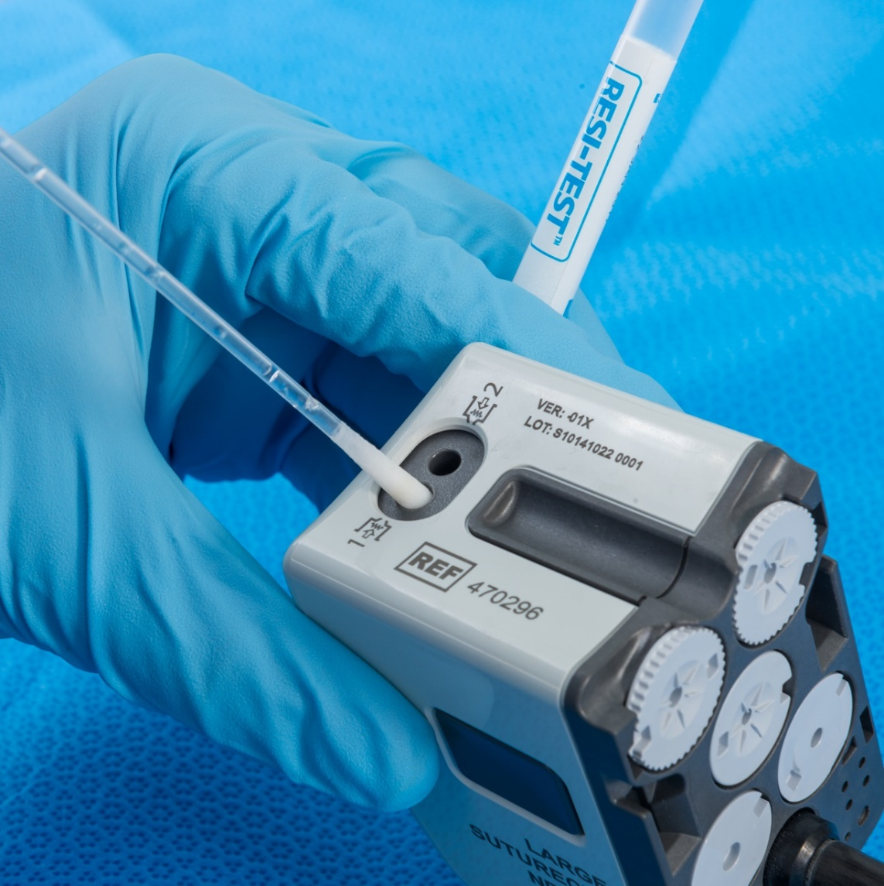
Inspection for Residual Soil
Lighted magnified inspection
Borescope
Residual soil tests
  Many types
  Frequency and scope determined by facility
  Risk assessment
Things to Check
Check lighted magnification
How and when the borescope is used
Residual soil testing in risk assessment
Review soil testing records
Notes:
ANIMATION
Click to see post-it
SCRIPT NOTES:
Inspection for residual soil happens in both the dirty and clean sides of the department but follow the same processes. Surfaces are inspected under magnification for visible soils. Borescopes may be used to inspect lumens. These devices look like a super thin endoscope. The tip is inserted into the lumen where a lens and light can illuminate areas of residual soil within the lumen.
As AAMI standard ST79 states , some soils may not be visible to the human eye. Facilities should consider testing for these invisible soils. Several residual soil tests are available. Facilities must determine the best soil test for their specific situation.
Facilities must also establish criteria for acceptance. This should be based upon the manufacturer's written IFU.
The types of devices tested, the frequency of testing and the actions to take when a test fails is dependent upon the facility’s risk assessment. Typically, verification of a cleaning process looks at all equipment, carts, racks and staff members who will have responsibility for cleaning the device. After the process is verified, a routine schedule is established that looks at those devices found to have the highest risk of residual soil.
(Click) When auditing this area look for lighted magnifying glass. They should be clean, in good working order and used.
Confirm how and when borescopes are used. Review the manufacturer’s written IFU to confirm that cleaning and disinfection of the borescope is carried out correctly.
Review the risk assessment for decontamination. Was residual test soil testing listed in the assessment? Do the test records show that items identified in the assessment are tested at the listed frequency.
Additional information:
None

Slide 37
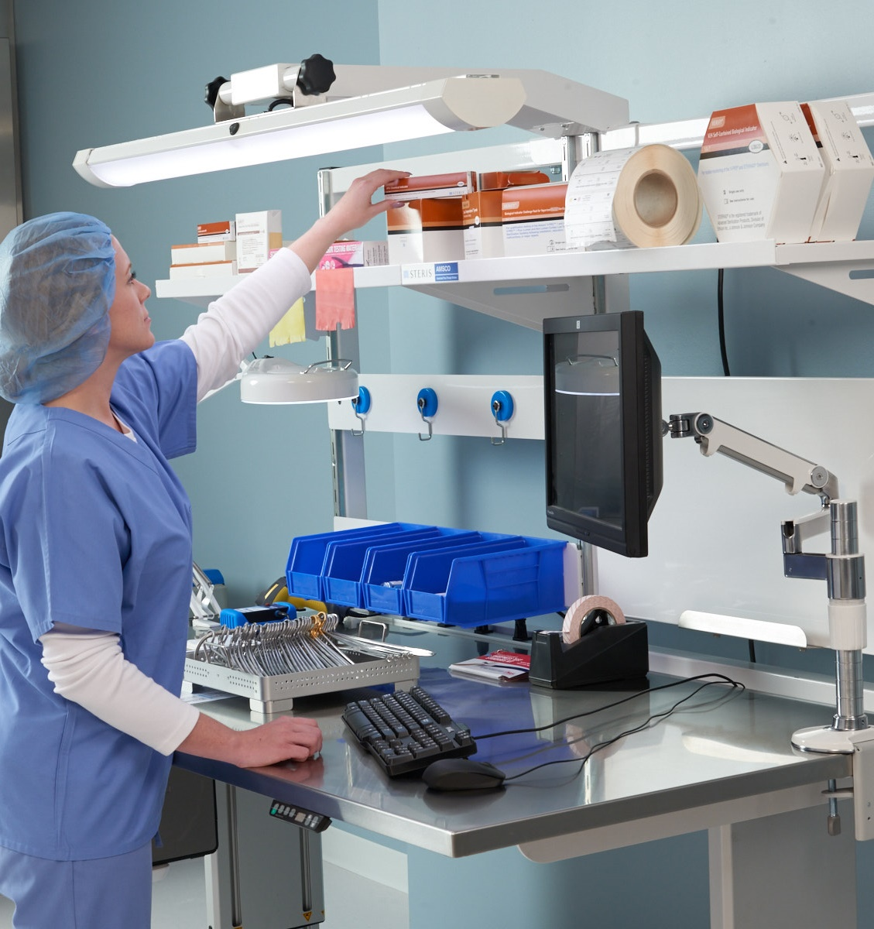
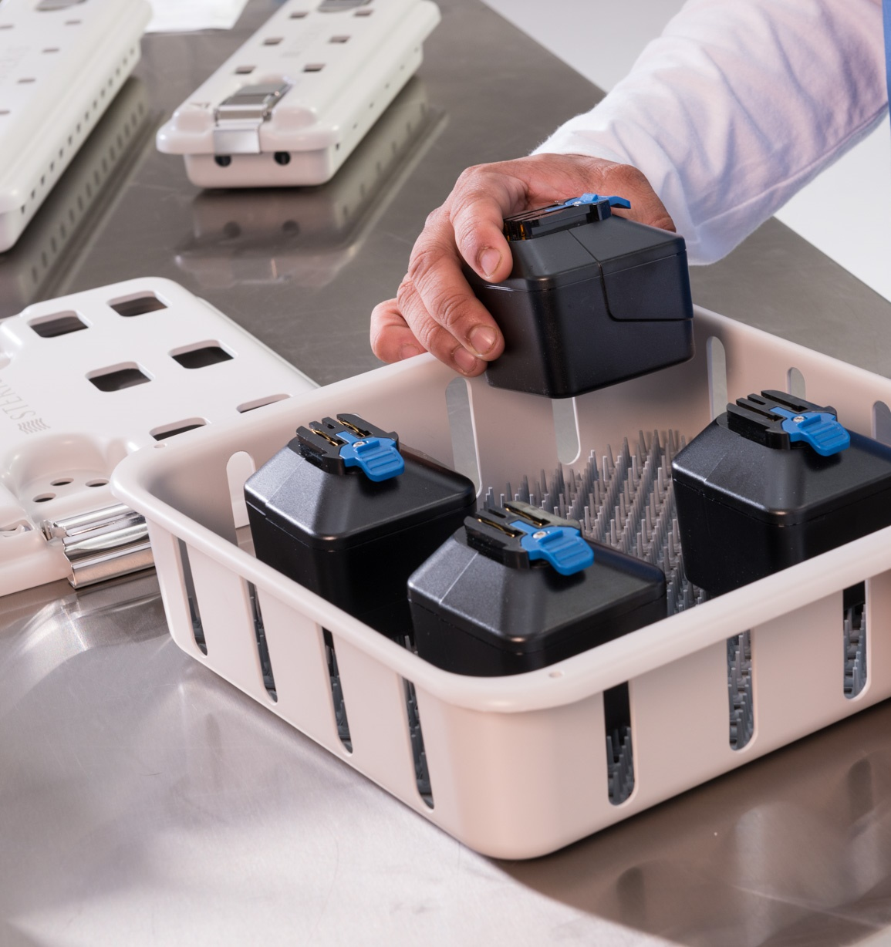
Assembly / Prep & Pack
Notes:
Transition slide
SCRIPT NOTES:
Once devices are clean, rinsed and dried; it is time to prepare them for the next process.
Additional information
None

Slide 38
Assembly / Prep and Pack
Assemble & Lubricate
Pack
Inspect
Notes:
SCRIPT NOTES:
Clean dry devices move into assembly and prep and pack. Devices are inspected, assembled, lubricated, if needed, and prepared for the next step. This may mean packing them for sterilization. Those are listed as separate steps; they often happen at the same.
Additional information
None

Slide 39
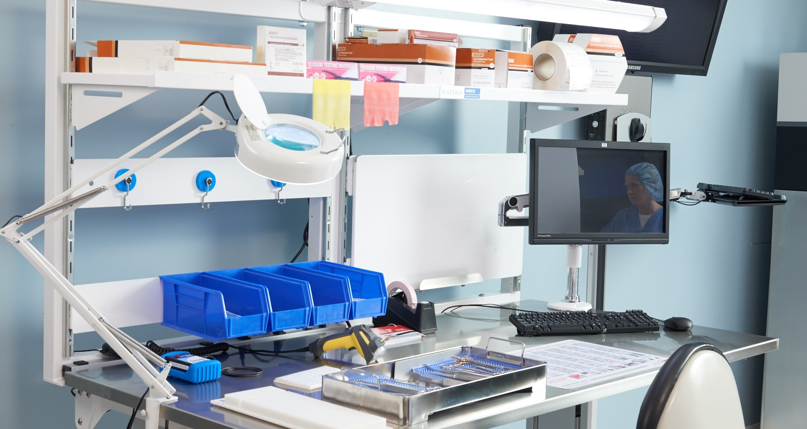
Workstation
Organized / clean
No food, lotions, drinks, etc.
Notes:
SCRIPT NOTES:
The workstation should be organized and clean with no personal items on surfaces or in drawers. Food, lotions, drinks and other personal items can bring microorganisms in from the outside.
The area should be regularly clean and disinfected. Bins and draws should be emptied and clean regularly.
Additional information
None

Slide 40
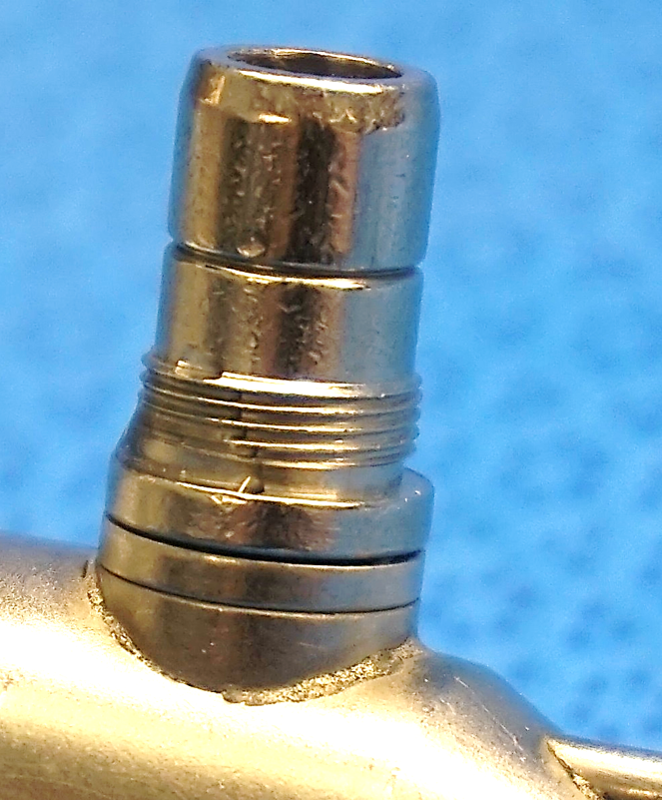
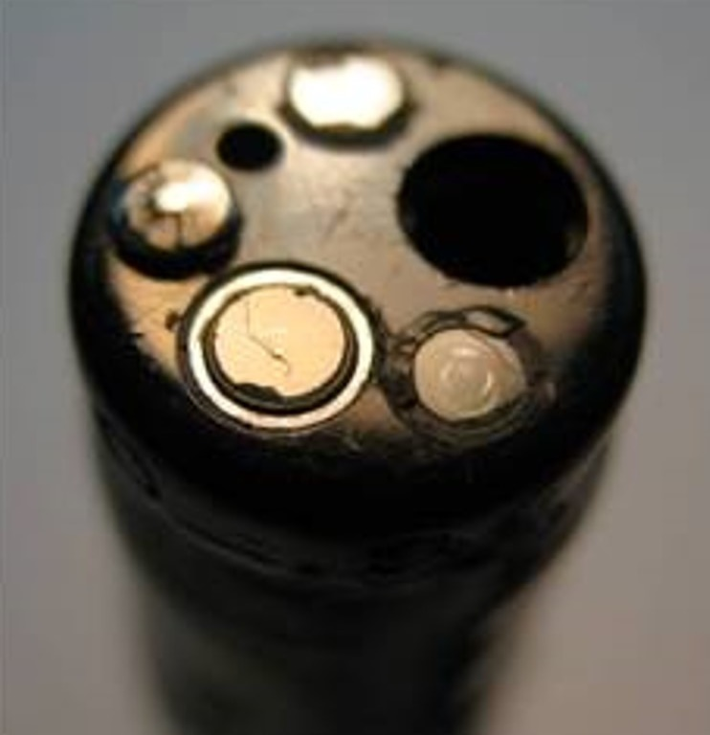

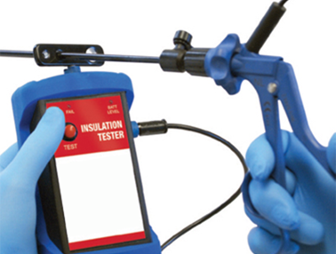
Inspection
Lighted magnification / borescope
Visible soil & soil tests
Moisture
Device damage
Functional testing
Lubrication, if applicable
Things to Check
Lighted magnification and borescope
Residual soil testing is completed
Review the damage device process
Confirm medical grade lubricants
Notes:
ANIMATION:
Click to see post-it
SCRIPT NOTES:
Assembly staff visually inspect each item carefully to detect any visible soil or residual soil. Lighted magnification and borescopes are used here too. Soil test are invaluable tools on the clean side. Items processed through automated washers can only be evaluated on the clean side. Users should ask device manufacturers to provide test procedures that can easily be replicated and that can assist users in recognizing whether cleaning was effective for all device areas. Such tests are particularly important for devices with components that cannot be readily inspected for cleanliness (e.g., spring hinges, lumens, porous material, crevices etc.)
As mentioned, residual moisture is detrimental to the process. All surfaces, including those beneath caps or threaded areas, must be checked for moisture.
Devices must be fully functional and not damaged. This is also the place that devices are reassembled and lubricated.
Not every device requires lubrication. It is important to identify those that do, and then use medical grade lubricant designed for medical device if needed. Never use a lubricant that is not specifically designed for medical instrumentation. Commercial lubricants, such as WD40, can have components that could be toxic to the delicate tissues of the body.
(Click) When auditing this part of the process, always check the tools are available and in good working order. This includes lighted magnification and borescopes. Just like before, review the residual test soil testing and its records.
Walk through the damage device process. How are they found? what happens to them next? are they accounted for?
Lastly, check all the lubricants used. Confirm that they are medical grade and only used on the devices who’s IFU calls for lubrication.
Additional information
The lubricant manufacturer should provide evidence to support material compatibility and biocompatibility (e.g., lack of cytotoxicity) of the lubricant for its intended use (e.g., following sterilization). ANSI/AAMI ST79: 2017 Section 7.4.4.2.2 Instrument Lubricants

Slide 41
Assembly Prepares Device & Device Sets
High Level Disinfection
Liquid Chemical Sterilization
Terminal Sterilization
Notes:
SCRIPT NOTES:
Assembly prepares the device or device set for the microbiocidal process. This could be high-level disinfection, liquid chemical sterilization or terminal sterilization. Each type of process has important device preparation requirements detailed in the manufacturer's IFU and the device's manufacturer's IFU. Terminal sterilization processes have the most steps and considerations when preparing devices and devices sets.
Each type of terminal sterilization process has its specific requirements. This presentation will focus on steam though many of the conditions presented for steam can translate to other sterilization processes.
Additional information:
None

Slide 42
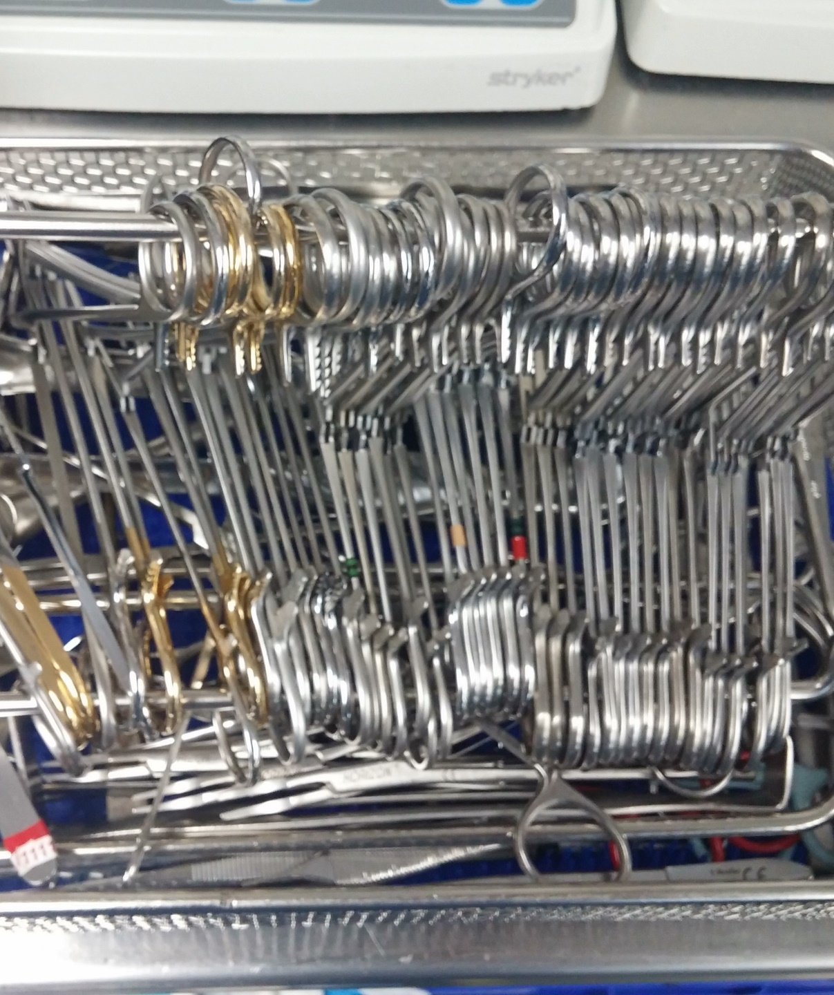
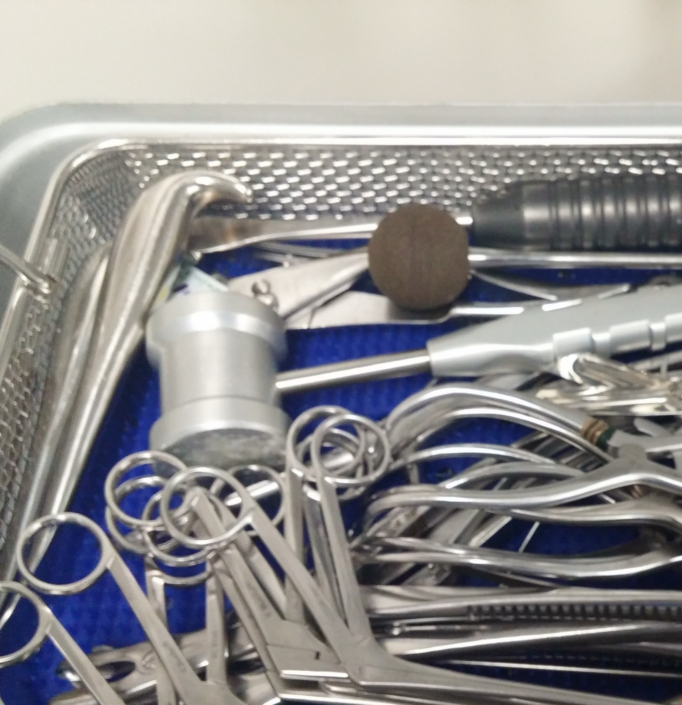
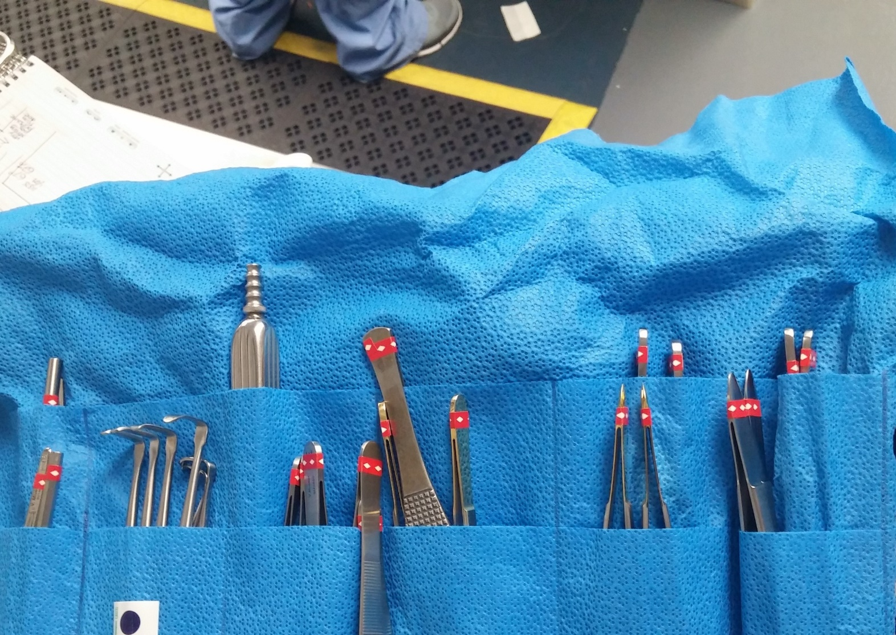
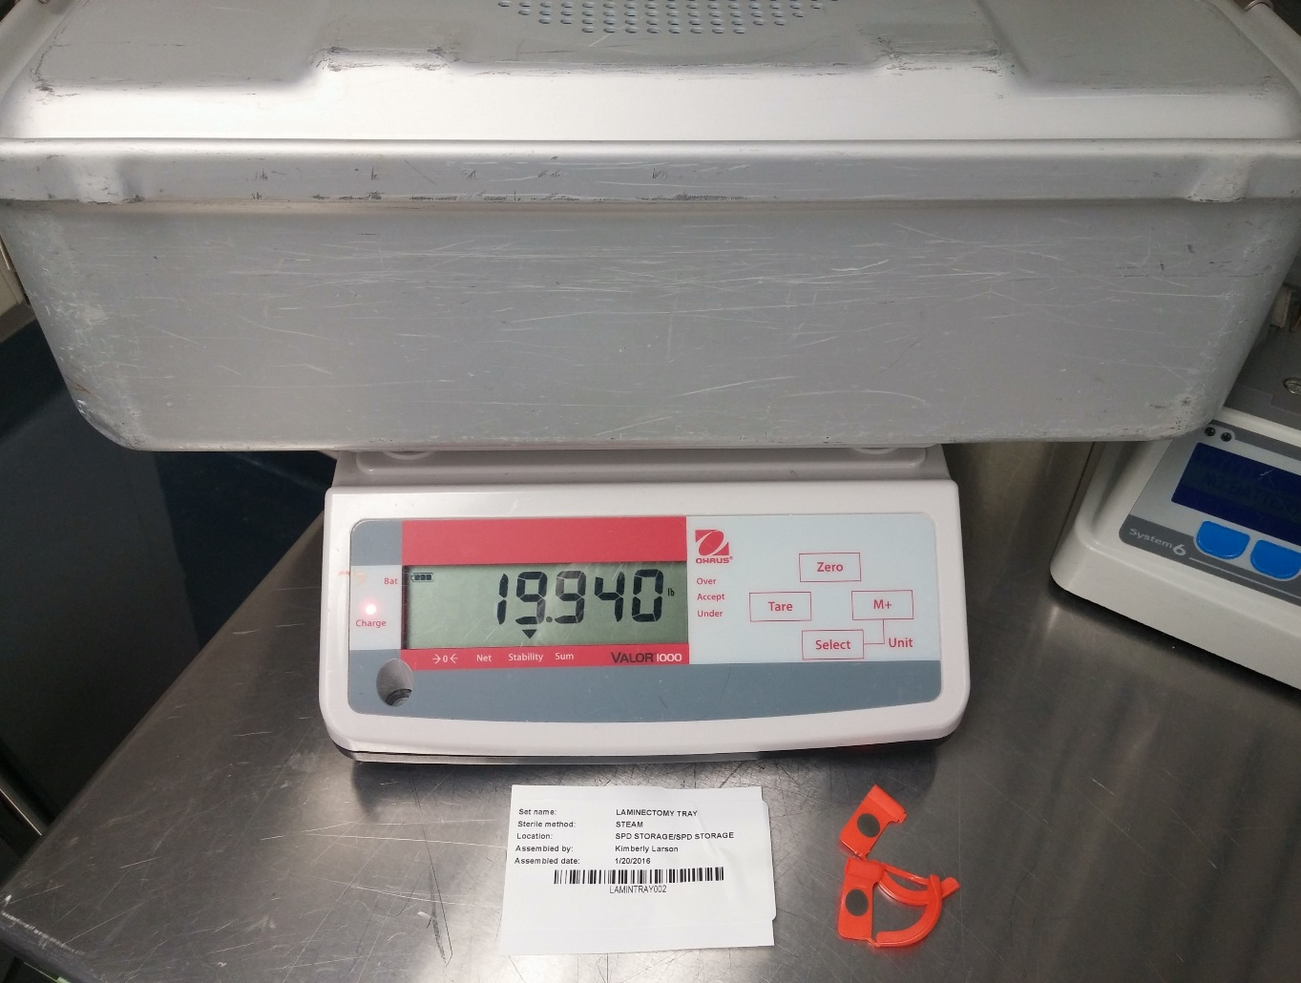
Assembly - Steam
Instrument Labeling
Instrument positioning
Set weight
Water
Notes:
SCRIPT NOTES:
Devices are often gathered into sets. Sets are typically specialized for the procedure they support but general sets are also used. Several methods can be used to identify devices that go together in one set. Of these, color instrument tape is most common. However, instrument tape is challenging for maintenance and is often questioned by surveyors. The tape must be applied per manufacturer’s written IFU, inspected and changed if there is any lifting, chipping, or glue seeping out from under the tape. It can be a time-consuming task to maintain the tape and costly if an instrument repair company maintains if for you.
Devices must be positioned to allow steam to contact all surfaces of the device; rachet locks un-ratcheted; box locks and lumen ports open. Several items are used to maintain instruments in an open position. Stringers are the most common. However, positioning cards and tip protectors can also so this.
When placed into a containment device, such as a container tray or pouch, devices should be evenly dispersed. Delicate instruments should be protected from heavier instruments in the set. . Cords and tubing should be loosely coiled.
Each type of containment devices and sterilizer model dictates a maximum weight per containment device. Additionally, devices may also have specific requirements.
Few devices require the injection of water into lumens. For those that do, the instrument manufacturer's written IFU should be followed. The IFU should detail the volume and type of water to be used, The last note about water is really condensate from the steam sterilization process. Condensate forms as steam contacts cool surfaces. This can pool on concave surfaces. It is important that all concave surfaces are positioned to allow drainage of condensate.
Additional information:
None

Slide 43
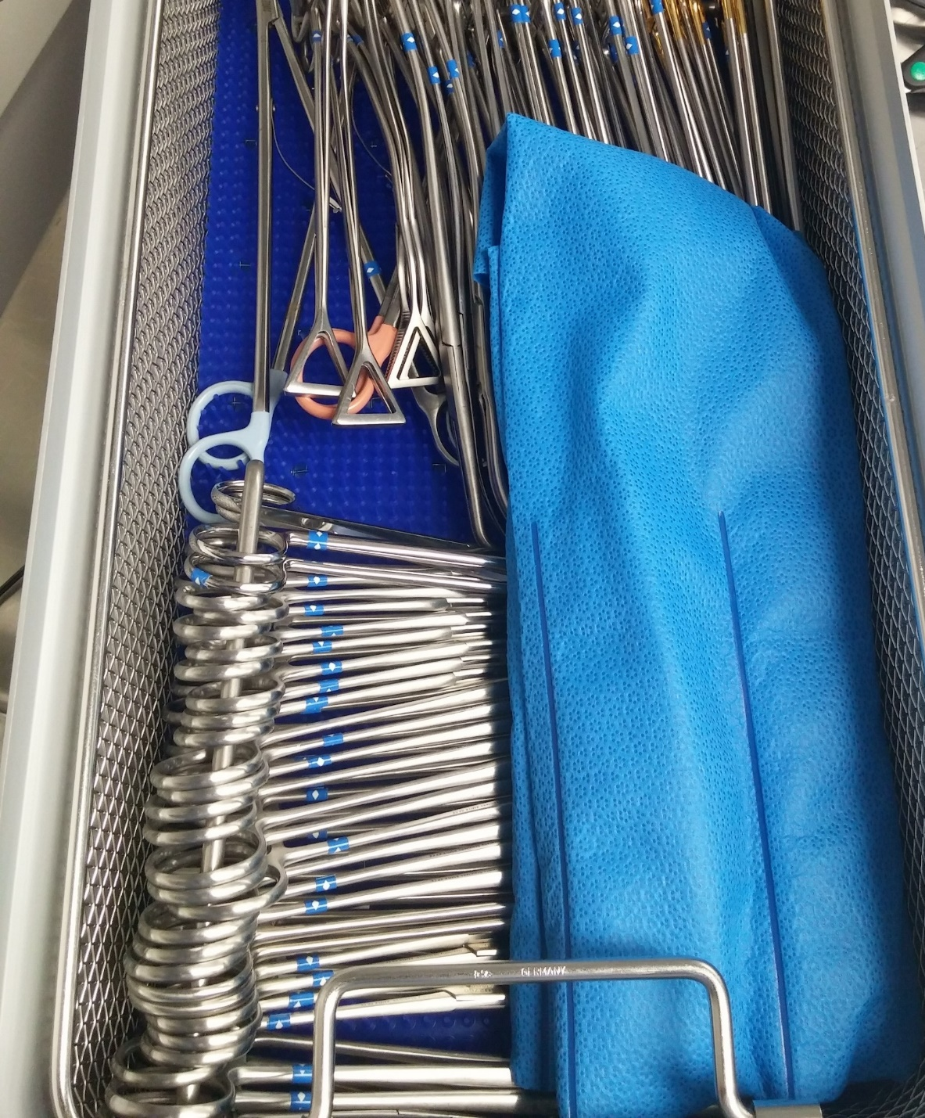
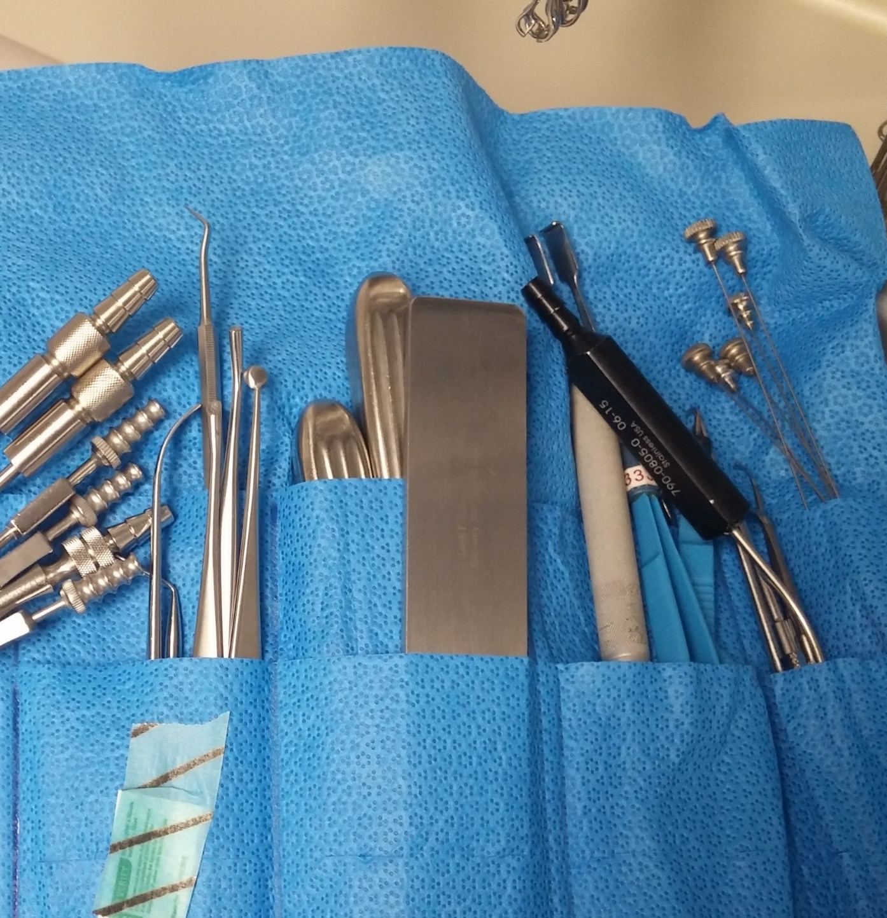
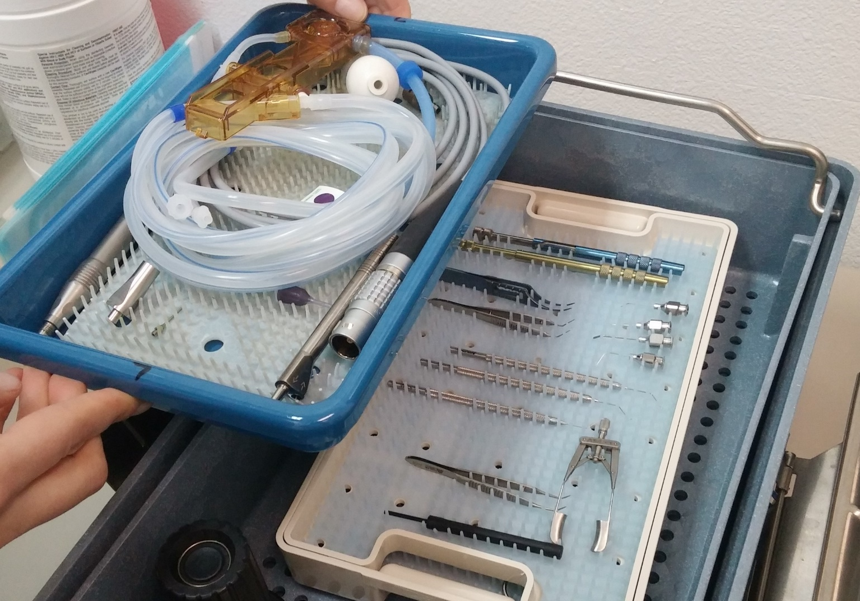
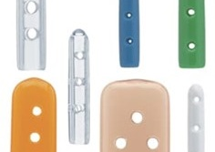
Assembly – Instrument Protection
Instrument holders / pouches
Tip protectors
Mats
Notes:
SCRIPT NOTES:
Delicate devices within sets are protected in many ways. Specialized instrument holders or sterilization pouches placed within sets protects delicate devices from the other devices in the tray or container.
Tip protectors keep delicate device tips safe and prevents sharp devices from damaging instruments or packaging materials. Tips should be loose to allow sterilant penetration but not so loose that they fall off.
Mats help to secure devices in place protecting against damage during transport and handling. They should also allow for the removal of condensate. Typically, the more drainage holes the better the matt.
All instrument protection must be validated for the sterilization process and containment device that it will be used in. The manufacturer's IFU should be followed.
Additional information:
None

Slide 44
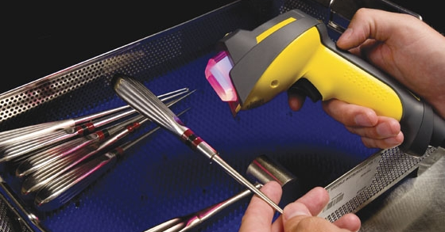
Things to Check
Things to Check
Things to Check
Staff competency
Reconcile IFU for set weights
Tip protector and matt use
Check on water and personal items
Compatibility for accessories, devices and containment devices
Notes:
ANIMATION
3 post-it, click 3 times for each to fade in
SCRIPT NOTES:
Assembly is very important to ensure sterilant penetration. Though we have provided examples of steam sterilization, these principles are true for all sterilization and processes.
(Click) Check staff competencies for device inspection, assembly, set assembly and all accessories including but not limited to tip protectors, containment devices and matts. Manufacturer written IFUs should be available to and followed by staff.
Review all set weight recommendations and reconcile to the lowest acceptable weight.
(Click) Confirm that devices, containment devices and accessories are validated for the sterilization process.
(Click) Check that matts, tip protectors and other instrument organizers are used correctly.
Follow-up on water use for specific instrument and remove any personal lotions, food and drinks from the work area.
Additional information:
None

Slide 45
Packaging & Labeling
Small
Light-weight
Items
Use before Expiration Date
Correct Weight & Size
Inspect for Defects
Store per IFU
Correct Filters & Accessories
Inspect for Damage & Cleanliness
Non-toxic ink
Load label
Tamper arrow
Packaging tape
Notes:
SCRIPT NOTES:
Packaging for any item that is being sterilized must protect items and ensure maintenance of sterility during sterilization and subsequent handling.
There are three types of packaging commonly used for items to be sterilized. Peel pouches, sterilization wrap (muslin, non-woven disposable, and other woven wrap materials), and rigid sterilization containers. The type of packaging to be used is dependent on the individual item/set being packaged.
Peel pouches are designed for packaging single instrument light-weight or a small number of light-weight instruments:
There are 3 types of seals heat, self, and tape seal.
Ensure all seals are smooth
If double pouching, ensure the manufacturer’s validated instructions for use are available.
No folding of inner pouch.
Use the peel pouch per manufacturer’s written IFU, some have expiration dates that the pouch must be used.
Sterilization wrap can be either woven muslin or other types of reusable fabric wrap, or non-woven disposable sterilization wrap. Non-woven wrap may consist of single layer wrap that requires two layers of wrap sequentially wrapped, or a two-layer bonded wrap that provides a one-step simultaneous wrap method.
Rigid sterilization containers have been available in the U.S. market since the late 1970s. Containers are constructed of a variety of materials such as anodized aluminum and plastic composite materials. The container manufacturer’s instructions for care and use must be followed to prevent damaging the container surfaces. Ensure cleaning chemistries used to clean containers are compatible with the container materials.
Some container systems have reusable and/or disposable filters, some are filter-less and contain valve mechanisms, but all have gaskets that assist in maintaining a secure fit between the container bottom and lid. Only use filters validated with the containers, do not cut wrap or use a different manufacturer’s filter.
Inspect for damages such as cracks or dents, filter and valve mechanisms may also become damaged if not maintained properly.
All container systems have weight restrictions based on the container size. Manufacturer’s instructions for the maximum weight for each container size should be followed, along with guidance on stacking containers during sterilization, and post-sterilization shelf life.
All containers and accessories must be cleaned after each use, even if the OR states the containers were removed from the room prior to the patient entering.
Labeling products have their own IFUs as well, and each should be followed, some basics for labeling include but are not limited to:
Write on plastic of peel pouch only.
Write on tape only not on wrap.
Ink should be non-toxic.
All labeling should be visible, and legible.
Each package should have a load label visible.
Additional information
None

Slide 46
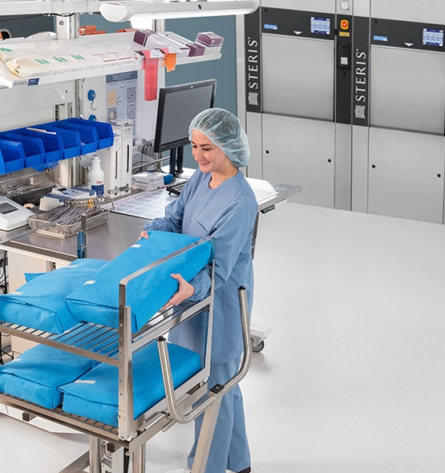
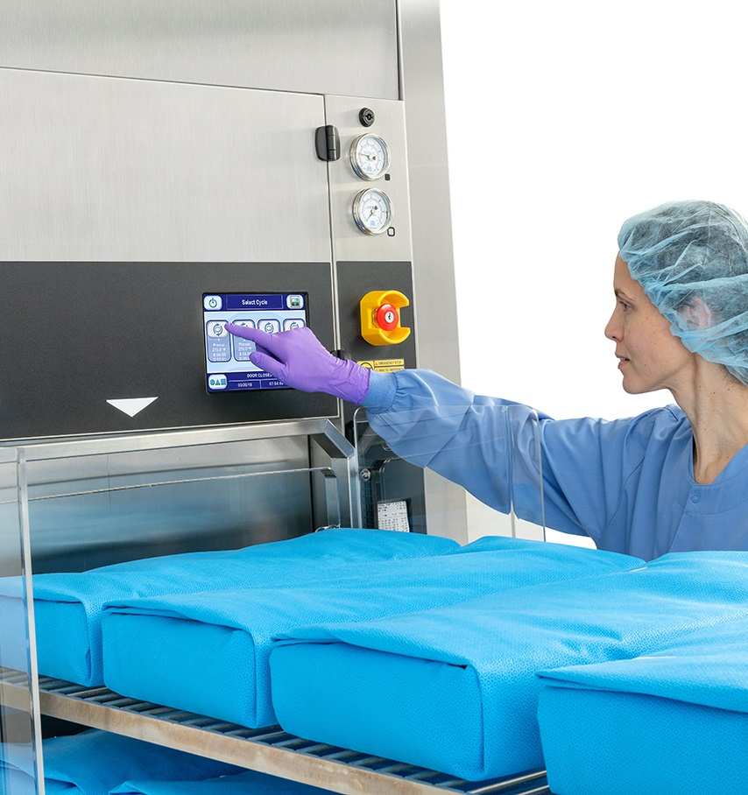
Sterilization
Notes:
Transition slide
SCRIPT NOTES:
As you have seen, many items can lead to residual soil or moisture in and on devices undergoing sterilization that hinder sterilization allowing for biofilm formation. There are also special conditions for specific sterilization platforms.
Additional information
None

Slide 47
Assembly / Prep and Pack
Sterilization
Release & Storage
Loading
Notes:
SCRIPT NOTES:
Sterilization involves three steps.
Items are placed within the sterilizer directly or on a carriage which goes into the sterilizer. After the sterilizer is loaded, the correct cycle is selected to sterilize the items. Following sterilization, the load is released, and items placed in storage. Each step requires adherence to manufacturer written IFU, standards and guidelines, and facility procedures. In fact, there are several tasks performed outside of the sterilization cycle itself.
Additional information
None

Slide 48
Sterilization
Loading, Product ID, Traceability
Testing and Monitoring
Load Release, Failures
Preventative Maintenance
Notes:
SCRIPT NOTES:
Sterilization is a complex and intimidating process which surveyors will always survey with diligence.
It becomes essential that the auditors for this area understand the processes as well as the guidelines. As previously stated, items are loaded and sterilized within the sterilizer.
Sterilizer testing and monitoring of the sterilization process is essential to ensure sterilization of items. Successful testing and cycle monitoring gives confidence in the release of sterilized items. They also capture failures in the process that may lead to nonsterile devices.
Lastly, sterilizers and sterilizer accessories are equipment which require preventative maintenance to ensure peak performance.
Additional information
None

Slide 49
Sterilization Processes
Steam
Vaporized Hydrogen Peroxide
Ethylene Oxide
Notes:
SCRIPT NOTES:
There are three main terminal sterilization processes. Steam Sterilization is the most common. The second is a Low temperature process which uses vaporized hydrogen peroxide as the sterilant. The third and last is not typically found in ASCs. However, it is still found in some sterile processing departments in hospitals.
Additional information:
None

Slide 50
Steam Cycle Choice
Gravity
Prevacuum
Steam-Flush Pressure-Pulse (SFPP)
30 min exposure at 250°F
4 min exposure at 270°F
4 min exposure at 270°F
15 min exposure at 270°F
3 min exposure at 275°F
3 min exposure at 275°F
Extended Cycle
Longer exposure or dry time
Few validated accessories
Few validate sterility assurance products
Things to Check
Load Weight
Extended cycles
Standardized cycles
Notes:
ANIMATION
Click to see post it note
SCRIPT NOTES:
Steam sterilizers use three different ways to remove air from the load and penetrate the items within the load with steam.
The first method is gravity. This method uses gravity to remove the colder heavier air from the load and replace it with steam. Two very typical cycles include a 30-minute exposure time at 250°F or a 15-minute exposure time at 270°F.
Pre-vacuum and steam-flush pressure-pulse, or SFPP, sterilization methods use dynamic air removal techniques. Pre-vacuum cycles draw a vacuum in the chamber to actively pull air from the load. SFPP cycles uses high pressure to atmospheric pulsing to actively draw air from the load. Both use 4-minute exposures at 270°F and 3-minute exposures at 275°F.
Each sterilizer model and cycle will indicate a maximum load weight. The load weight restrictions is in addition to the containment device weight requirements previously discussed.
Though many devices list at least one of these standard cycles, there are many that do not. They may have longer exposure times or even require longer dry times. These cycles are the extended cycles. We typically see these cycles for some of the spine and orthopedic devices. There are many challenges with extended cycles. There are few options for validated packaging and sterility assurance products resulting in off label use.
Some facilities have chosen to group devices under one exposure time, such as ten minutes. This exposes devices that require less than 10 minute to extra steam which may shorten their expected use life.
Review the device validated cycle parameters listed in the device’s IFU against what is performed. Be sure that the right cycle is used. Avoid extended cycle times unless absolutely needed. Also consider any practice that standardizes to one cycle. Confirm with device manufacturers that devices can be processed at the longer exposure times.
(Click) When auditing sterilization, confirm that the correct load weights are used. Pay close attention to the need for extended sterilization cycles. Watch for all the things we just spoke of. Be especially cautious of standardizing. Its good to standardize. Just make sure that you have the documentation to support your decision.
Additional information
None

Slide 51

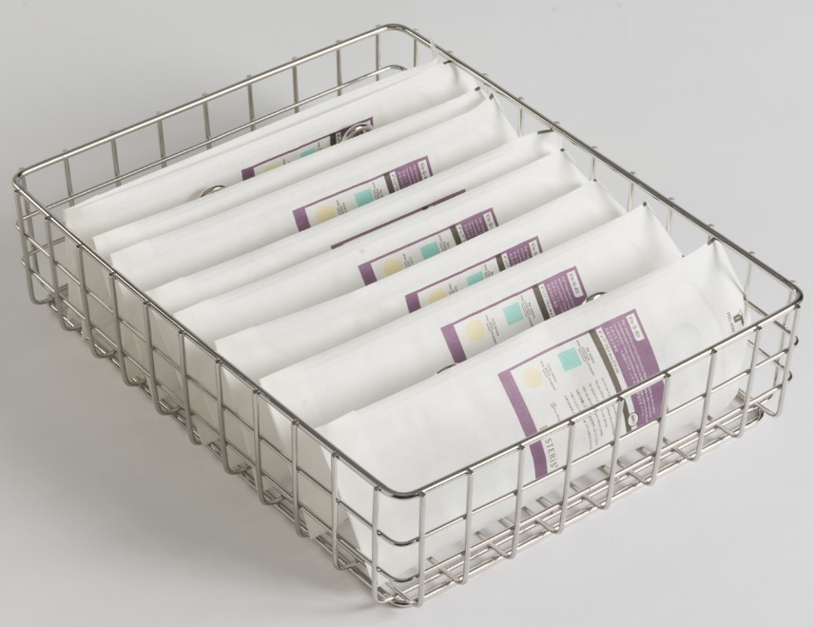




Loading - Steam
Pouches and textiles on edge
Containers and trays flat
Basins tilted to drain
Heavy on the bottom
Notes:
SCRIPT NOTES:
Loading requires both space and consideration of condensation. Items are loaded in a way to promote steam penetration. Textiles are placed loosely on the cart or rack so that the textiles are perpendicular to the rack.
Peel pouches are placed on edge and in the same direction, the plastic side of one against the paper side of the other.
Basins are tilted on edge and placed in the same direction
Wrapped items and containers are placed flat.
The position in the sterilizer is dependent upon the amount of condensate produced. Those with less condensate are placed on the rack above those with more condensate. In general, from top to bottom it goes textiles, peel pouches, basins, wrapped items and then containers.
Additional information
None

Slide 52

Unloading
Low traffic area
Away from vents
Notes:
SCRIPT NOTES:
After the load parameters and sterility assurance tests have been evaluated, the load must be allowed to cool. even if a sterilization failure is detected. We’ll touch more on sterility assurance later on in this presentation.
Items should be allowed to cool to room temperature before handling. During cooling, the sterilizer cart should be placed in a low-traffic area and away from air-conditioning or other cold-air vents as rapid cooling can create internal condensation leading to contamination.
An infrared or other temperature-sensing device may be used to verify that sterilized items have reached a defined temperature (e.g., 24°C [75°F]). The time allowed for cooling should consider the type of sterilizer being used, the design of the device being sterilized, the temperature and humidity of the ambient environment, and the type of packaging being used.
Items should not be touched during the cooling process. Items should remain on the cart. For sterilizers without carts, items should be transferred to draped cooling rack to prevent condensation from forming.
Additional information
“Warm items should not be transferred from the cart to cold metal racks or shelves for cooling or placed within dust covers before completion of the cooling process.”
ANSI/AAMI ST79: 2017 Section 10.3

Slide 53
Immediate-Use Steam Sterilization
Decontamination
IUSS Container
IUSS Cycle
Urgent Clinical Situations
Things to Check
IFU available and followed
Competencies complete
Container validated of IUSS
Volume and reasons are consistent with CMS guidelines
Immediate Use
Notes:
ANIMATION
Click to see post it
SCRIPT NOTES:
Immediate-use steam sterilization, or IUSS, are steam sterilization cycles that, due to shortened exposure times or dry time, provide the fastest sterilization turn time. It is intended for the reprocessing of urgent clinical instrument needs, such as when a unique instrument touches a non-sterile surface and is needed again in the procedure. It is not used to quickly turn instruments or instrument sets with low inventory levels or late vendor deliveries.
Though IUSS are cycles with the shortest processing times, devices must still go through all the steps of decontamination required by the manufacturer's written IFU before they are sterilized. This includes disassembly, soaking, cleaning and rinsing. Simply rinsing a device in a scrub sink is not appropriate.
Devices are placed within container systems validated for IUSS cycles that meet the device manufacturer's written instructions for IUSS. The container must have a lid that protects sterilized items from contamination during transport to the OR.
Several IUSS cycles are available. The person performing IUSS must use the one dictated by the manufacturer's written IFU.
After the IUSS cycle, devices are often wet. For this reason, devices are used immediately. Immediately implies that a sterilized item is used during the procedure for which it was sterilized; it is used in a manner that minimizes its exposure to air and other environmental contaminants; and it is intended for use now, not stored for future use nor held from one case to another.
(Click) Surveyors have been focusing on IUSS. They are concerned not only how it is done but why it is done. Some key things to check when auditing IUSS practices include but are not limited to:
Confirm that the manufacturer’s written IFU is available and followed by all staff members performing IUSS cycles. Staff performing IUSS should be trained, and competencies assessed
Ensure the rigid container is validated for IUSS cycles and the manufacturer’s written IFU is followed for care & maintenance.
Check sterilization records for volume and reasons of IUSS cycles. Ask the question, “why are you using IUSS to sterilize that item”, ensure staff can articulate a reason other than we don’t have enough instruments.
Now let’s talk about the second common sterilization platform, hydrogen peroxide.
Additional information
None

Slide 54
VHP Cycle Choice
Lumen Cycles
Non Lumen Cycles
Flexible Cycles
Lumen or cannulated devices
No lumens or cannulation
Flexible endoscopes
Mixed loads
Mixed loads
Different Types
Standard VHP
Gas plasma
VHP with ozone
Things to Check
Right cycle
Compatible
IFU / Device Matrix
Notes:
ANIMATION
Click to see post it
SCRIPT NOTES:
There are several models and makes of vaporized hydrogen peroxide sterilizers. Sterilization cycles are dedicated to specific load contents. Lumen cycles are used to process items that are cannulated or have lumens but are not flexible endoscopes. They can also contain items with no lumens.
Non-Lumen cycles are for loads that may have device restrictive areas like hinges or box locks but do not have lumens or cannulations.
Flexible cycles are designed for flexible endoscopes. Though some can also contain accessories or other devices.
Each sterilizer type and cycle will be restricted by total load weight and the number and size of the lumens present in the load.
There are three types of vaporized hydrogen peroxide systems. The standard VHP sterilizer only uses hydrogen peroxide gas to kill and air aerations to remove the peroxide.
Gas plasma sterilizers also use hydrogen peroxide to kill. The addition of plasma at the end of the sterilant hold times helps to remove hydrogen peroxide form the system by creating a short-lived plasma state of hydrogen peroxide.
The last type uses a second sterilant, ozone, after the initial hydrogen peroxide sterilant hold time to assist in the microbiocidal process.
(Click) Regardless of the type, there are specific things to consider during the audit. Ensure that the right cycle is used for the items in the load. Specifically confirm that the number and total quantity of lumens is consistent with the sterilizer’s written instruction for use.
Ensure that all items in the load are compatible. This includes load stickers and count sheets.
Ensure that devices are validated for sterilization within the unit. Confirm that the sterilization process is listed in the device manufacturer's IFU or that the device meets the requirements identified in the sterilizer’s written manufacturer IFU. Some sterilizer manufacturers may have device matrices available. The matrices may be used to confirm a device’s compatibility and cycle type to use when sterilizing in a vaporized hydrogen peroxide process.
Additional information
None

Slide 55



Loading - VHP
Placed flat
Do not touch plasma coil
Follow loading charts
Plasma Coil
Notes:
SCRIPT NOTES:
Items are loaded in a way to promote gas penetration and per the Manufacturer’s IFU. Peel pouches are placed on edge and in the same direction, plastic side of one against the Tyvek side of the other.
Wrapped items and containers are placed flat.
Do not stack items and if a plasma coil is present, packages should not be touching this coil.
Additional information
None

Slide 56

Unloading
Use gloves
Notes:
SCRIPT NOTES:
After the load parameters and sterility assurance tests have been evaluated, the load is removed. Even if a sterilization failure is detected. We’ll touch more on sterility assurance later in this presentation. Though no harmful residuals should remain after sterilization, gloves must be worn when removing items as a precaution to protect users from potential Hydrogen Peroxide contact.
Additional information
ANSI/AAMI ST58: 2017 Annex H 4.1.4.2

Slide 57
Sterilization Process Monitoring
External chemical indicators
Process challenge device
Internal chemical indicators
Cycle print out
Biological indicators
Special tests
Notes:
SCRIPT NOTES:
Sterilization process monitoring devices include physical monitors, external chemical indicators, internal chemical indicators, Biological Indicators, and Process Challenge Devices. Process challenge devices (PCD), are items designed to constitute a defined challenge to the sterilization process. They contain, a chemical indicator, biological indicator or both a chemical and biological indicator. There are also special tests used to monitor specific aspects of the sterilization process. An example of a special test is the Bowie-Dick test.
Each of these devices plays a distinct and specific role in sterilization process monitoring, and each is indispensable.
Sterilization process monitoring should include:
Monitoring of every package and sterilization load.
Routine monitoring of sterilizer efficacy.
Qualification testing of the sterilizer after installation, relocation, sterilizer malfunction, major repairs, and sterilization process failures.
Periodic product quality assurance testing.
Physical monitors verify the parameters for the cycle have been met.
The chemical indicators verify that one or more conditions necessary for sterilization have been achieved within the package and/or at a specific location within the load.
Biological indicators verify that the conditions at a location within the load were adequate to kill a population of microorganisms resistant to the sterilization process and demonstrate the lethality of the sterilization process.
While we could spend an entire hour or more on this subject, this slide is to introduce you to the tools the SPD should using and reviewing per manufacturer’s written IFUs.
Additional information
None

Slide 58


Sterility Assurance
Qualification
Load release
Routine monitoring
Package release
Product quality assurance testing
Things to Check
Qualification test records
Routine and load monitoring standards
Product testing?
Notes:
Click for each, discuss purpose of each step
Click to highlight package release
SPD responsible for all but Package Release
SCRIPT NOTES:
We know that we cannot know for certain that instrument sets/devices are sterile and ready for patient use when removed from the sterilizer. However, we do know that if we follow the AAMI recommendations for monitoring our processes there is a high probability that the instrument sets and devices, that we are sterilizing, are indeed sterile.
Sterility assurance testing starts at installation and continues throughout the sterilizer’s life. AAMI ST79 defines 5 processes.
Qualification testing verifies the sterilizers performance before it is used.
Routine efficacy testing confirms the steam sterilizer's ability to kill all microbes.
Load release utilizes a variety of tools to check that the process for a specific cycle was successful.
Package release involves interpretation of internal test indicators prior to using instrumentation in a procedure.
Product quality assurance testing verifies the procedures used to prepare, pack and steam sterilize facility items.
(Click) This area will take time to audit. You must be familiar with all the equipment in the department, the standards for monitoring that equipment and the location of the test record. Review the qualification records. Are they complete? Was the testing complete in the current location of the equipment?
Is routine testing proceeding as scheduled? Have there been sterilization failures? What was done? Many US facilities have not completed product testing. Don’t be one of them. Check that devices are well represented in the testing and that nothing has changed that would require redoing the test.
Let’s take a closer look at a couple of these sterility assurance monitoring requirements.
Additional information:
Sterility assurance recommendations can be found in ST79 section 13

Slide 59
When is Qualification Needed?
Installation
Relocation and changes in utilities
Major repairs
Sterilization malfunctions or failures
3 consecutive test cycles
Process Challenge Device (PCD)
Special Tests, if applicable
Notes:
Review each
SCRIPT NOTES:
According to the AAMI guidelines, qualification testing is performed after installation or relocation, and after malfunctions, sterilization failures or major repairs. Testing requires three consecutive test cycles to show passing biological indicator results, If a special test, like a bowie dick test, is required; it must also show passing results in three consecutive test cycles.
A major repair is defined as any repair outside the scope of normal maintenance. Some examples of major repairs associated with steam sterilizers include
Weld repairs to the chamber
Changing the door or vacuum pump
And upgrades or repairs to the controls
Preventative maintenance may include rebuilding of specific valves or replacement of specific parts. These are not considered major repairs.
Many ASC fail to perform this testing or may no longer have the original documentation to support it. Surveyors will ask for this information!
Additional information
Resource: ST79:2017, section 13.8

Slide 60


Option
Physical Monitors
Chemical Process Challenge Device
Biological Process Challenge Device
External Chemical Indicators
Things to Check
Implant load monitoring
Record complete
Are loads quarantined
Load Release
Notes:
ANIMATION
Click to see green checks, every cycle
Click to see implants, every implant
Click to see Option, raise the bar on safety
Click to see post-it
SCRIPT NOTES:
Healthcare facilities use four types of process monitoring when deciding to release a load: cycle parameters, external chemical indicators, chemical process challenge devices and biological process challenge devices.
(Click) Physical monitors are reviewed, and all external chemical indicators are checked after every sterilization cycle.
For non-implants, the load release should be an active decision that is based on evaluation of all available data from the sterilization process for the load. The staff member reviews the printout, or cycle parameters have been met for the load. They also inspect all external indicators for passing results. The load is released when everything is passing. Failure to meet any cycle parameter or evidence of failing external indicators shows a problem with the sterilization cycle. The load must be reprocessed. Loads that do not meet the criteria for release should be clearly identified so that they are not mistakenly distributed.
(Click) Biological Process Challenge Devices are used in every load that contains an implantable device. AAMI states that implantable devices have the greatest risk to infection and as such require additional verification of successful sterilization. The cycle parameters, external indicators and result of the biological indicator must all show passing results for the load to be released.
Biological indicators must have time to allow the bacteria to grow and be detected. The time needed depends on the type of BI. One type may give a result in 20 minutes while another type may require 24 hours. Items from a load monitored with a BI should NOT be used until all the results, including the BI results have been reviewed. The load must be quarantined in such a way to prevent use of the items before the load is released.
(Click) Some facilities take the option to raise the bar of safety by using chemical process challenge devices. These provide additional assurance that the cycle performed as required. It may be used to release loads that do not contain an implantable device. However, loads with implantable devices must wait for the BI results to be released.
(Click) Check that every load with an implant has a BI result. Review several load records. Is the document complete? Has the printout been reviewed? Be sure to look at the IUSS sterilization cycles. Was the IUSS log completed. Are they true emergencies or is it making up for inventory shortages?
Be sure to observe the load release practice. Are items being sent for use before the BI results are known? Are loads in a location away from traffic and easily identifiable as quarantined?
Additional information:
None

Slide 61

Emergency Release
Documented medical exception
Exception not rule
Policy and procedures
Trending
Things to Check
Trending
Actively reducing IUSS usage
Notes:
ANIMATION
Click to see post-it
SCRIPT NOTES:
Releasing any item in a load, especially implants, before the BI results are known is unacceptable and should be the exception and not the rule.
When documented medical exceptions dictate (e.g., trauma-related, orthopedic screw-plate sets are needed), it could be necessary to release an implantable device before the BI results are known. In this case, the release of the device before the BI results are known should be documented; the BI results obtained later should also be documented. It is critical that his documentation be fully traceable to the patient.
Emergency situations should be defined in written policy and procedures developed in consultation with infection prevention, the surgeon, and risk management.
Steps should be taken to reduce the frequency of emergency release of implantable devices. Auditing of Exception Forms and implant logs should be routinely performed to identify any trends or consistent patterns of events that are causing emergency release and that could be corrected.
(Click) Review the emergency release and IUSS records. Are they truly exceptions or is there an inventory shortage or back-to-back scheduling creating a need of emergency release or IUSS. Is the department actively pursuing ways to reduce the quantity of items that undergo an emergency release or IUSS sterilization cycle.
Additional information
None

Slide 62

Documentation Needs
Notes:
Transition slide
SCRIPT NOTES:
Documentation falls into four buckets, equipment records, facility records, sterilization records and administrative records. Four buckets of documentations. Of these administrative records are usually assumed to be management responsibility. However, staff have responsibility for some of the administrative records.
Additional information
None

Slide 63
Equipment Records, continued
Tests
Equipment cleaning & verification
Leak test
Bowie-Dick test
Routine biological indicator
Qualification test results
Product testing test results
Notes:
SCRIPT NOTES:
All tests must be documented, results evaluated, and actions taken when not within specification. This includes cleaning indicators and verification tests, equipment specific tests, chemical and biological indicator tests. It also includes the reports detailing product testing. It doesn’t stop here.
Additional information
None

Slide 64
Equipment Records
Service & Maintenance
Daily maintenance activities
Preventative maintenance records
Repair records
Calibration records
Installation records
Relocation records
Changes to equipment parameters settings
Notes:
SCRIPT NOTES:
Maintenance records both daily and preventative must be maintained. Repair, calibration and installation records must be retrievable. Of course, equipment that has been moved will also need the testing, calibration and qualification records.
You may be surprised to learn that changes in equipment parameter setting must be justified and documented. This is especially true when equipment is being used in ways not found within the equipment’s IFU.
Additional information
None

Slide 65
Facility Records
Maintenance
Corrective actions for steam delivery system
HVAC parameters by room for the department
Tests
Assessment of steam quality
Assessment of water quality (tap and treated)
Routine testing of safety equipment, such as eyewash stations
Notes:
SCRIPT NOTES:
Facility records that affect the sterile processing department must also be documented, retained and accessible. These include things like corrective actions for steam deliver, HVAC parameters and room monitoring, steam and water quality tests and even routine testing of safety equipment like eye showers.
Additional information
None

Slide 66
Sterilization Records
Records
Load/lot number identification
Detailed load content list
Sterilizer cycle printout
Sterilization cycle parameters
Operator identification
Biological indicator PCD results
Chemical indicator PCD results
Notes:
SCRIPT NOTES:
Sterilization records are kept for every sterilization cycle. The load is assigned a unique ID or lot number. To this ID, a complete list of load contents and all the documentation generated and reviewed for load release is tracked. This includes the cycle printout, results of PCDs and the operator's signature.
Additional information
None

Slide 67
Sterilization Records cont’d
Records
Reports of inconclusive or non-responsive chemical indicators
Emergency release documentation
Traceable
Notes:
SCRIPT NOTES:
Sterilization records my also include inconclusive or failing chemical indicators found in the OR and associated with the load. Emergency release documentation is also traceable back to the load. Full traceability is needed. Traceability of the items and packs used in a procedure to the sterilization cycle it was processed in. Traceability helps during sterilization failure investigations and recalls, should they be necessary.
Additional information
None

Slide 68
Administrative Records
Records
Competencies
Audit findings and corrective actions
Additional medical device instructions
Failure tracking and corrective actions
Recall records
Critical supplier communications / recalls
Loaned equipment transactions
Continuous quality improvement records
Things to Check
Audit documentation
Compare against the standards
Notes:
ANIMATION
Click to see post it to review checks for all record keeping
SCRIPT NOTES:
There are many administrative records specific to sterile processing. Some include competencies for all aspects of the decontamination and sterilization process, depart audit findings and corrective actions, additional instructions, wall charts or other instructional tools provided by vendors, sterilization and chemical indicator strip failure trending and tracking, recall documentation, loaned instrument set tracking and continuous quality improvement records.
(Click) Remember to audit documentation for completeness. Compare policies and procedures against Sterile Processing standards found in AAMI, AORN and other standards.
Additional information
None

Slide 69

Types of Electronic Documentation Systems
Document management systems (DMS)
Semi-automated systems (SAS)
Workflow management systems (WMS)
Things to Check
Audit documentation
Compare against the standards
Notes:
ANIMATION
Click to see post it
SCRIPT NOTES:
With so much documentation to manage, manual record keeping can be overwhelming. Electronic documentation is often used to alleviate the paper challenge.
Three main types of electronic documentation. Each builds upon the capabilities of the previous.
Document Management Systems, or DMS, is the simplest of all. DMS stores files in a time stamped grouping. Files can be downloaded from equipment, scanned documents such as spread sheets and word documents.
Semi-automated systems, or SAS, houses all the same electronic files of the DMS but ads to this by automating some of the functions. SAS systems can provide alerts to complete takes or reminders to include biological indicators. An example of a SAS system is instrument tracking systems.
The last system incorporates both the DMS and SAS systems while adding a utility function. The Workflow Management Systems, or WMS, automate the collection of important records, integrate the output of equipment and schedules the work that must be done. WMS systems will go so far as to identify which tray of instruments should be worked on next.
Not every facility needs all the function of the WMS. However, most facilities are participating in some form of electronic documentation.
(Click) Whether paper or electronic, auditing is the same. Check that data is available, the conclusions meet the objectives, and the documentation has been reviewed and approved. Compare policies and procedures against Sterile Processing standards found in AAMI, AORN and other standards.
Additional information:
None

Slide 70

General Considerations
Notes:
Transition slide
SCRIPT NOTES:
Up until this point we spoke about the process of cleaning, rinsing, drying, disinfecting and sterilization of medical devices. Now we’ll focus on areas of sterile processing that should be regularly audited but are not directly related to the process. The first is personal protective equipment.
Additional information
None

Slide 71




Personal Protective Equipment (PPE)
Dirty Side
Clean Side
  Cap/hair cover
  Facility laundered scrubs
  Shoe covers
Things to Check
Right PPE for the job
Observe use
Donning and doffing
Face shield
Surgical mask
Fluid resistant gown
Chemical gloves
Chemical gloves
Thermal resistant gloves
Safety googles / glasses
Notes:
ANIMATION
Click for box of unique needs of dirty side
Click for unique needs of clean side
Click to see post-it
SCRIPT NOTES:
Personal Protective Equipment, or PPE, is mandatory, but there are so many reasons employees give for noncompliance. “Its to Hot” or “its just a little case., it will take longer to gown up.” Not only can staff members be seriously injured but it is the LAW. The Occupational Health and Safety Administration, or OSHA, mandates the use of PPE based upon the responsibilities and exposures of the staff member.
Sterile processing activities roughly divide into two activity zones, the dirty side where cleaning and decontamination happens, and the clean side, where assembly and sterilization occur.
Both sides require caps or hair covers; facility laundered scrubs; and shoe covers. These protect the staff member from accidental exposure and protect the items they are working with.
(Click) The dirty side has additional threats from exposure to contaminated body fluids, tissues and aerosols during the cleaning process. Staff must be protected further by using a face shield and surgical mask to keep contaminated fluids and aerosols out of the face, nose and throat mucosa. Fluid resistant gowns prevent exposure of skin to contaminated fluids. Lastly, chemical resistant gloves protect against contact with the cleaning chemistries. disinfectants and contaminated devices.
(Click) The clean side has additional safety concerns as well. Chemical resistant gloves protect against contact with the disinfectants, sterilants and potentially contaminated manually cleaned devices. Thermal protective gloves protect workers from hot surfaces and items undergoing steam sterilization. There may also be times where safety goggles or glasses are needed to protect staff from eye injuries.
(Click) Auditing this area requires knowledge of bloodborne pathogen requirements and the safety equipment needed for all the chemicals and equipment used to process devices. Review PPE requirements and check supplies. Observe staff use of PPE. Even if the same person does the cleaning, rinsing, assembly and sterilization; they should change to appropriate PPE as they move through the processing steps. Remember that the apron and gloves could contain deadly bacteria the could transfer to clean disinfected devices.
Also review the donning and duffing practices of staff. Is it done in a manner that prevent contamination of self or others.
Additional information
None

Slide 72
Environment
Decontamination
Assembly
Sterilization
Sterile Storage
Notes:
SCRIPT NOTES:
The environment plays a critical role in controls contamination in sterile processing departments. Surveyors will always inspect the environment is each area, we will review some key hot spots for compliance and survey in the following slides
Additional information
None

Slide 73


Traffic Patterns - Decontamination
Notes:
SCRIPT NOTES:
Decontamination areas should be off limits to anyone other than authorized personnel. Not only should everyone entering the area wear appropriate PPE, but also facility provided scrubs, or a hospital approved cover suit.
A challenging area may be outside vendors delivering loaned instrument trays, vendors should know the facility policy and adhere to it.
Doors should be kept closed and have appropriate signage indicating cleaning processes are taking place and that appropriate attire is required.
Additional information
ANSI/AAMI ST79:2017 section 3.2.3 discusses Traffic Control in restricted and unrestricted areas of the SPD.

Slide 74

Lighting
Task Lighting
No Shadows
Notes:
SCRIPT NOTES:
Good lighting is essential in decontamination areas. Besides excellent general lighting consider lighting over the sink for better identification of soil and cleaning. When the light is behind the technician, the technician may cover the light casting a shadow reducing the scope of vision.
Here are three helpful tips about lighting work surfaces:
As people age, they need a high amount of illuminance. We need bright light!
When speed is of the essence, more light is needed.
Lighter colors reflect light; darker colors absorb light therefore, the greater the reflectance, the less illuminance is required. That is why we wear light colored clothing in the summer.
Additional information
Table 1-IES-recommended illuminance levels for work environments is on p. 20 of ST79:2017

Slide 75

Temperature & Humidity
Notes:
SCRIPT NOTES:
Finding the right temperature and humidity for each area can be challenging. ANSI/ASHRAE/ASHE 170, Ventilation of Health Care Facilities, list recommendations for temperature and humidity. However, it is also important to consider the temperature and humidity restrictions of the items stored or used in those areas. Before setting room requirements, gather a multidisciplinary team to assess operating conditions of equipment, storage conditions of disposable items used by sterile processing, storage requirements of sterilized items, and the storage requirements of vendor supplied items.
Once established, temperature and humidity must be monitored. Policies and procedures should indicate the specifications and actions to take when the temperature or humidity do not meet those specifications. Remember, it may be necessary to dispose of supplies or reprocess sterile items that have been exposed to adverse temperature and humidity conditions.
Additional information
ANSI/AAMI ST79: 2017 removed the temperature & humidity table and now states to refer to the ASHRAE Document.
ANSI/AAMI ST79:2017, 3.3.5.5 Heating, ventilation, and air conditioning (HVAC) operating parameters
The health care organization should identify which version of ANSI/ASHRAE/ASHE 170 will be used based on when the HVAC system was initially installed or last upgraded. The health care facility should establish and implement systematic processes for monitoring HVAC performance parameters and a mechanism for identifying and resolving variances within the rooms throughout the facility where sterile processing occurs.
Facility engineering personnel or designated responsible personnel should establish policies and procedures for monitoring and maintaining HVAC parameters within the sterile processing areas. Procedures should include maintaining records of monitoring results that are retrievable either from a central system or a local log.
If a variance in the HVAC parameters occurs, sterile processing personnel in combination with a multidisciplinary team (e.g., facility engineer, infection preventionist, risk manager, sterile processing manager or other designated personnel) should conduct a risk assessment. The sterile processing department is defined by ANSI/ASHRAE/ASHE 170 as a critical area.
The risk assessment should include the storage recommendations from the manufacturer’s products such as cleaning chemistries, washer & sonic indicators, chemical indicators, biological indicators, packaging material etc.
Temperature & humidity should be monitored daily and documented. Surveyors will check the logs and may question staff as to the procedure for when it is out of range.
See also Annex Q.
Rationale: The effect of the HVAC system parameters falling out of range is variable. A small variance for a short period of time might not be of clinical concern, whereas a large variance for a longer period could have clinical significance. A risk assessment provides necessary information to guide appropriate response measures
Resource: ST79:2017, 3.3.5.5, p. 19

Slide 76




Hand Hygiene
DO NOT
Notes:
SCRIPT NOTES:
Hands are an ideal place for bacteria to live. Hands are also the ideal carrier since they touch everything. Good hand hygiene reduces the threat of transmission.
Nails should be kept short and clean. Do not use nail polish, artificial nails or jewelry.
Additional information
None

Slide 77



Hand Hygiene
Wash hands
Medical grade lotions
Alcohol-based product
Hand washing stations
Things to Check
Nails
Personal lotions
Observe practice
Notes:
ANIMATION
Click to see post-it
SCRIPT NOTES:
Policies and procedures should describe the frequency and techniques used to keep hands clean. Only use medical grade soaps and lotions, approved by infection prevention. Alcohol-based hand hygiene products should be regularly used on visibly clean hands. However, hand washing with soap and water is the best way to remove soils.
Hands should be washed with soap and water whenever gloves or other PPE is removed.
Hand washing stations should be in each area of sterile processing and personal support rooms, like locker rooms. Hand washing sinks should be separate from sinks used to clean instrumentation and emergency eye wash stations.
(Click) Check for jewelry, polish and false nails. When auditing hand washing compliance within the Sterile processing department, check for the use of personal lotions or hand sanitizers. These may be stored away in draws at workstations. Also observe hand washing and hand sanitizing practices. Are staff washing hands after removing gloves? Are the regularly using alcohol hand sanitizers as dictated by facility policies.
Additional information
Handwash stations should
be located in or near all areas in which instruments and other devices are decontaminated and prepared for sterilization, as well as in all personnel support areas (e.g., toilets, lounges).
be considered in the design or renovation of a sterile processing department/area
have a backup system for operation during power outages, if electronic sensors are used.
ANSI/AAMI ST79: 2917 Section 3.3.5.7
Fingernails should be kept short and clean and should not extend beyond the fingertips (CDC, 2002a; CDC, 2003; AORN, 2017).
ANSI/AAMI ST79: 2017 Section 4.4

Slide 78






Emergency Eye Wash Station
Things to Check
10 s
0.4 Gallons per 15 Mins
Both Eyes
15-43°C / 60-100°F
Test records
Cleaning and disinfection frequency
Path
10 s
Notes:
ANIMATION
Click to see post-it
SCRIPT NOTES:
Speaking of emergency eye wash stations …
Eyewash/shower equipment must be available within 10 seconds travel time, with unobstructed access, for immediate emergency use in all locations where potentially corrosive chemicals are used. This would include high level disinfectants, liquid sterilant, chamber cleaners and other chemicals with corrosive contact hazards listed in the safety data sheet.
When the chemical is not corrosive but still a hazard, an intervening door can be present, provided it opens in the same direction of travel as the person attempting to reach the emergency eyewash-shower equipment. The door must not be locked preventing access to equipment.
Drench hoses or eyewash bottles are not acceptable emergency eyewash units. The eyewash facilities should be identified with a highly visible sign, maintained in accordance with manufacturer’s written IFU, tested routinely to ensure proper operation.
Eyewash stations should not be in a location that requires flushing of the eyes in the decontamination sink.
Plumbed eyewashes/facewashes and showers should be tested weekly to verify operation and ensure that the flushing solution is available. Eye wash and showers should provide 0.4 gallons in 15 minutes. Each eye should be flowed. Water should be at 15-43°C or 60-100°F to prevent injury.
Any source of water can be a source of biofilms. Stations must be regularly cleaned and disinfected to prevent biofilm formation.
(Click) When auditing the safety showers and eye washers, review the test records. Are they current with acceptable results? Also confirm the cleaning and disinfection schedule has been followed. Always check the path to the shower and eyewashes. They should be free of obstructions.
Additional information
None

Slide 79





Surfaces
Have:
Smooth
Nonporous
Compatible
Avoid:
Textured
Porous
Non-compatible
Notes:
SCRIPT NOTES:
Cleaning and disinfection is very important. Facilities should be designed to promote effective cleaning and disinfection. All surfaces, including floors, walls, cabinets, equipment and counters, should be made of smooth non-porous materials that are compatible with cleaning and disinfectant chemistries. Avoid textured or porous materials. Textures and pores can hide bacteria and soils making soil removal and disinfection hard.
Avoid rugs and matts as these can harbor and protect microorganisms. Be sure that chair surfaces can be cleaned and disinfected.
Walls should allow for cleaning and disinfection. They must be compatible with cleaning and disinfection. Additional, bumpers, corner protectors and chair rails should be nonporous and compatible with cleaning and disinfection chemistries.
Ceilings should be constructed of non-fiber shedding materials. Vents, sprinklers and other items hanging from ceilings or walls should allow cleaning.
Additional information
None

Slide 80






Sources of Environmental Contamination
Notes:
SCRIPT NOTES:
Contamination is everywhere. Every item, button or switched touched becomes a source of contamination. These should be regularly cleaned and disinfected.
Additional information
None

Slide 81
Environmental Services (EVS) in SPD
Cleaning protocol for each area
Checklists
EVS staff competency
Things to Check
Trash & Linen Schedule
PPE and Attire
Cleaning Chemistry
Disinfectants
Notes:
ANIMATION
Click for posit note
SCRIPT NOTES:
As you probably noticed, cleaning and disinfection of the counters, workstations, equipment, walls and floors is an integral part in controlling contamination and infection transmission. Who does your cleaning and disinfection? If you are like many, EVS staff arrive after everyone else is gone. They may be permanent staff, or they may be from an agency. Don’t assume EVS staff are trained on the specifics for cleaning and disinfecting sterile processing.
Ensure the department is cleaned routinely and appropriately. There should be a cleaning protocol for each area. EVS Staff must be trained.
Develop a cleaning checklist. BE sure to identify the …
trash & linen disposal schedule
proper PPE and attire for each area
cleaning chemistry and disinfectant to use
what is EVS staff responsibility and what is SPD staff responsibility
Sequence of cleaning from cleaner areas to dirty areas.
(Click) When auditing the environment, don’t forget the EVS. Check schedules are established and kept. Be sure EVS staff where PPE and understand the IFU of the cleaning and disinfection chemistries being used.
Additional information
None

Slide 82


Storage
Notes:
Transition slide
SCRIPT NOTES:
The final responsibility in the processing loop is storage of processed items.
Additional information
None

Slide 83


Sterile Storage
Clean and organized
Restricted access
Environment monitored
Cleaned regularly
Notes:
SCRIPT NOTES:
Sterile storage areas should be cleaned and maintained the same way other restricted areas are. Shelving can be opened or closed cabinets but in open shelving the units should have solid bottoms to prevent dust or splashes from moping the floor for getting on packages. The area should have the temperature and humidity monitored and be cleaned regularly.
Additional information
None

Slide 84




Vertical storage
Closed cabinet
Things to Check
Storage
Hang time records
Hang Time risk Assessment
No touch
Filtered air circulation
Hang Time
Notes:
ANIMATION:
Click for post it
SCRIPT NOTES:
Facilities should ensure that scopes are clean and dry prior to storage.
Endoscopes should be hung vertically such that the scope does not touch the floor, walls or neighboring endoscopes. Scopes should be stored in cabinets that are closed to prevent recontamination. Cabinets with filtered air circulation can help dry any remaining moisture which can help prevent biofilm formation.
Though endoscopes are stored in a controlled environment, it does not eliminate the possibility of recontamination during storage. Facilities must establish a hang time. Hang time is the maximum number of days that an endoscope can be stored before it requires reprocessing. Hang times are determined by reviewing recommended practices, manufacturer IFUs and facility scope microbial test data over time.
(Click) Auditors should look at the endoscope storage. Are scopes stored correctly? Is hang time documented and observed? Review the risk assessment and testing used to establish the hang time. Do current practices match the recommendations within the risk assessment?
Additional information
None

Slide 85








Resources
Notes:
ANIMATION:
One click starts the automated sequence. Moves right to left, top to bottom
SCRIPT NOTES:
A complicated process can easily feel overwhelming. Being familiar with the standards and guidelines governing the sterile processing department is the first step to feeling comfortable auditing it. This list comprises the minimum standards and guidelines that you should become familiar with. If you don’t have them in your facility library, now is the time to get them.
Additional information
None

Slide 86
Action Items
Survey the SPD
Develop a plan to address gaps
Educate, train and assess
Notes:
SCRIPT NOTES:
This was a lot of information and you’re ready to get started. Prepare your audit checklist and follow your instrument processing. Don’t try to do it all in one go. Divide the processes and establish an auditing schedule.
Identify areas that you can improve and create a plan to do it. Sometimes as an auditor we want to fix but that doesn’t always work. Rely on your experts, standards, guidelines and other resources to help make and maintain the best changes.
Don’t forget that education is key. Educate those with responsibility for reprocessing instruments. Don’t forget those with the important task to pretreat instrumentation following the procedure. Train staff on the importance of following every step ion the process. No shortcuts. Finally assess competency. Not just once, but on a regular schedule.
Additional information
None

Slide 87

Infection Prevention…
It’s Everyone’s Responsibility
Notes:
SCRIPT NOTES:
Your audit will find things that can be improved upon. Remember that it is everyone's responsibility to prevent infection by paying close attention to all aspects of instrument reprocessing. Together, as a team, you will find solutions.
Additional information
None

Slide 88
References
American National Standard Institute/Association for the Advancement of Medical Instrumentation (2017). ANSI/AAMI ST79:2017 & Amendments A1, A2, A3, A4 (Consolidated Text) Comprehensive guide to steam sterilization and sterility assurance in health care facilities. Arlington, VA: Author.
American Society of Heating, Refrigeration and Air-Conditioning Engineers (ASHRAE) (2017) ANSI/ASHRAE/ASHE Standard 170-2017: Ventilation of Health Care Facilities. Atlanta, GA: Author.
Occupational Safety and Health Administration. Standard 1910.1030 Bloodborne pathogens: https://www.osha.gov/laws-regs/regulations/standardnumber/1910/1910.1030 downloaded 2/18/2021
ECRI (2020) Top 10 Technology Hazards Executive Brief: Learn how to identify health technology hazards in your facilities. https://www.ecri.org/landing-2020-top-ten-health-technology-hazards, downloaded 2/18/2021
Notes:
SCRIPT NOTES:
Several documents were used to support this presentation.
Additional information
None

Slide 89
References
American Society for Healthcare Engineering; The Facility Guidelines Institute. (2018) Guidelines For Design and Construction of Outpatient Facilities, Chicago, IL: American Society of Healthcare Engineering
Guide to Infection Prevention for Outpatient Settings: Minimum Expectations for Safe Care – Centers for Disease Control and Prevention; Centers for Disease Control and Prevention; https://www.cdc.gov/hai/settings/outpatient/outpatient-care-guidelines.html, downloaded 2/16/2021
International Association of Healthcare Central Service Materiel Management (2016). Central Service Technical Manual (8th ed.). Chicago, IL: Author.
Punke, Heather (2012) 10 Key Trends in Infection Control, https://www.beckersasc.com/asc-quality-infection-control/10-key-trends-in-infection-control.html, downloaded 2/18/2021

Slide 91

Obtain Your Certificate
Thank you for attending this CE activity
Scan the QR code with your smartphone’s camera
Enter the Course Code 6812
Complete the acknowledgement, provide feedback, and download your certificate
Notes:
DESIGNER NOTE:
This slide is only required for Instructor led programs.

Slide 93
Revision History
Date | Revisions | Revised By: | Notes
2/24/2021 | New Edition | Arthur Henderson | Initial release
11/28/2022 | Updated format to new template. Updated standard references. | H. Ames | None

