Slide 1
ASC & Hospital Drug Diversion
Dennis Wichern
Retired DEA Agent
Prescription Drug Consulting
www.prescriptiondrugconsulting.com

Slide 2
Disclosure
Faculty
Dennis Wichern
No conflict
It is the policy of the Ambulatory Surgery Center Association (ASCA) to ensure that all individuals who have the ability to control or influence the content of an educational activity disclose all financial relationships with any entity whose products or services are pertinent to the content of the educational activity. The financial disclosure will include the name of the entity, and the nature of the relationship the individual has with the entity during the time the relationship is in effect and for 12 months afterward.
Requirements for successful completion of the educational activity
Attendee must be present for the duration of the educational program
Completed evaluation form
Expiration of enduring materials
Contact hours will be awarded until October 31, 2020 for the educational program
ASCA is an approved provider for nursing contact hours by the California Board of Registered Nursing, Provider #6949
ASCA is an approved provider for Administrator Education Units (AEUs) by BASC Provider #3272
Commercial Support: None
Sponsorship: None

Slide 3
This presentation may include opinions, advice, statements, materials, data, images, videos, documentation, and other information (“Materials”) expressed or shared by presenters. The Materials are for informational purposes only, and the statements, views, and opinions expressed at any presentation, or in any Materials, are those solely of the presenter and not of ASCA. Further, ASCA does not endorse or recommend any specific presenter, promoter, company, or center, or any views mentioned at any conference or meeting, or in the Materials. Under no circumstances, will ASCA (or its directors, officers, employees, or agents) be liable for the accuracy, quality, or reliability of any of the presentations or Materials, or any defamatory, offensive, or illegal conduct of presenters, including but not limited to intellectual property infringement, or any direct, indirect, incidental, special or consequential damages arising from any presentations, or Materials.

Slide 4
Learning Objectives
Describe common drug diversion methods involving controlled substances and the risks they pose to your healthcare facility.
Identify important controlled substance security and techniques to prepare to prevent drug diversion.
Recognize practical strategies and tips to reduce opioid risk at your ASC while complying with federal law.

Slide 5
Who I Am
Retired DEA Special Agent in Charge - Chicago.
30 years of experience.
Worked through the Indiana “pill mill” crisis during 2005 through 2014.
Have been partnering with medical community/prescribers for last 10 years through CS programs.
Developer of CME and CLE prescription drug risk mitigation programs focusing on prescriber safeguards, DEA compliance, MAT, pain and drug destruction.
I am not an attorney.
Zero medical training.

Slide 6
What Type Drug?

Slide 7
DEA’s Primary Focus
Cartels, Gangs, and Criminal Organizations Trafficking Heroin, Fentanyl, Cocaine and Methamphetamine
Not ASC drug diversion
However, DEA has oversight of pharmaceutical controlled substances (CS’s)
And is required by law to review those that use CS’s daily

Slide 8
DEA’s Role with Medical Providers
DEA's authority under the CSA is not equivalent to that of a State medical board. DEA does not regulate the general practice of medicine.
The responsibility for educating and training physicians so that they make sound medical decisions in treating pain (or any other ailment) lies primarily with medical schools, post-graduate training facilities, State accrediting bodies, and other organizations with medical expertise.
DEA’s authority is limited to controlled substances only.

Slide 9
DEA’s Role with Controlled Substances
DEA’s statutory responsibility under the Controlled Substance Act (CSA) is twofold:
1) prevent diversion and abuse of drugs
2) ensure an adequate and uninterrupted supply is available to meet the country’s legitimate medical, scientific, and research needs.
DEA has no medical doctors on staff and must hire one to define standard of care.

Slide 10
Nationwide Registrant Population
 | 1/2018 | 9/2021
Practitioner | 1,274,570 | 1,364,387
NP’s & PA’s | 352,296 | 471,201
Pharmacy | 72,716 | 70,467
Hospital Clinic | 17,869 | 18,784
Manufacturer | 575 | 571
Distributor | 930 | 789
Researcher | 11,440 | 11,825
NTP’s | 1,583 | 1,917
Analytic Labs | 1,534 | 1,540

Slide 11
Minnesota Registrant Population
 | 1/2018 | 9/2021
Practitioner | 23,150 | 24,575
NP’s & PA’s | 8,142 | 10,044
Pharmacy | 1,156 | 1,025
Hospital Clinic | 194 | 179
Manufacturer | 13 | 13
Distributor | 13 | 13
Researcher | 217 | 222
NTP’s | 10 | 11
Analytic Labs | 33 | 36
Reverse Distributor | 3 | 2

Slide 12
Medical Professional Substance Abuse Statistics

Slide 13
Medical Professional Substance Abuse Statistics
https://www.addictioncenter.com/addiction/medical-professionals/

Slide 14
USA Today Article - 2014
The latest drug use data from the U.S. Substance Abuse and Mental Health Services Administration, released in 2007, indicated that an average of 103,000 doctors, nurses, medical technicians and health care aides a year were abusing or dependent on illicit drugs. Various studies suggest the number could be far higher; an estimated one in 10 practitioners will fall into drug or alcohol abuse at some point in their lives, mirroring the general population.
https://www.usatoday.com/story/news/nation/2014/04/15/doctors-addicted-drugs-health-care-diversion/7588401/

Slide 15
Medical Professionals Substance Abuse Statistics
Rates of addiction are highest in physicians within the specialties of anesthesiology, emergency medicine and psychiatry.
It usually comes down to access.
And occurs everyday across America.
https://www.addictioncenter.com/addiction/medical-professionals/

Slide 16
https://www.detox.net/uncover/drugs-in-the-workplace-industry-comparison/

Slide 17
The Background on Drug Diversion in Healthcare Facilities

Slide 18
https://ahia.org/AHIA/media/WhitePapers/WHITEPAPER_BakerTilly_Drug-Diversion-Internal-Audit_AHIA.pdf page 5

Slide 19
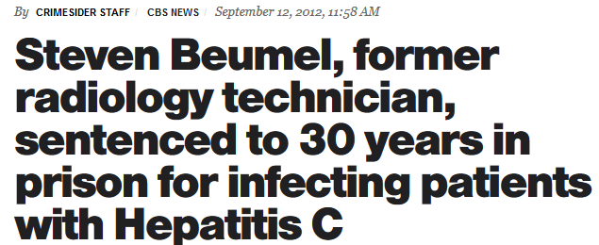
Hepatitis Outbreak – Florida, Mayo Clinic 2010
Radiology technician
Employed at Mayo Clinic from 2004 to 2010
Switched patients fentanyl syringes with saline solution infected with hepatitis C
Mayo Clinic implemented significant changes as a result of this case

Slide 20
The Mayo Clinic Response
https://assets.hcca-info.org/Portals/0/PDFs/Resources/Conference_Handouts/Regional_Conference/2014/Minneapolis/Dillonprint2.pdf

Slide 21
The Mayo Clinic Response
Unobserved single individual access to controlled substances
Unattended product during medication use process
Deviation from policy and procedures
Lack of audit process/known deterrent
Other process assessments
Identified 123 possible improvements.
https://assets.hcca-info.org/Portals/0/PDFs/Resources/Conference_Handouts/Regional_Conference/2014/Minneapolis/Dillonprint2.pdf

Slide 22
The Mayo Clinic Response
https://assets.hcca-info.org/Portals/0/PDFs/Resources/Conference_Handouts/Regional_Conference/2014/Minneapolis/Dillonprint2.pdf

Slide 23
The Mayo Clinic Response
https://assets.hcca-info.org/Portals/0/PDFs/Resources/Conference_Handouts/Regional_Conference/2014/Minneapolis/Dillonprint2.pdf

Slide 24
The Mayo Clinic Response The 77 Best Practice Elements
https://www.mayoclinicproceedings.org/cms/10.1016/j.mayocp.2012.03.013/attachment/968730c2-4b52-4bc4-9bf0-2ee56fa5532f/mmc1.pdf

Slide 25
The Mayo Clinic Response The 77 Best Practice Elements
https://www.mayoclinicproceedings.org/cms/10.1016/j.mayocp.2012.03.013/attachment/968730c2-4b52-4bc4-9bf0-2ee56fa5532f/mmc1.pdf

Slide 26
The Mayo Clinic Response The 77 Best Practice Elements
https://www.mayoclinicproceedings.org/cms/10.1016/j.mayocp.2012.03.013/attachment/968730c2-4b52-4bc4-9bf0-2ee56fa5532f/mmc1.pdf

Slide 27
The Mayo Clinic Response The 77 Best Practice Elements
https://www.mayoclinicproceedings.org/cms/10.1016/j.mayocp.2012.03.013/attachment/968730c2-4b52-4bc4-9bf0-2ee56fa5532f/mmc1.pdf

Slide 28
The Mayo Clinic Response Summary The 77 Best Practice Elements
Core principles
Storage & security
Procurement
Ordering & prescribing
Preparation & dispensing
Administration
Inventory & recordkeeping
Surveillance
Investigation & response
Education
Quality improvement
https://www.mayoclinicproceedings.org/cms/10.1016/j.mayocp.2012.03.013/attachment/968730c2-4b52-4bc4-9bf0-2ee56fa5532f/mmc1.pdf

Slide 29
What Drugs Should I Focus On?

Slide 30
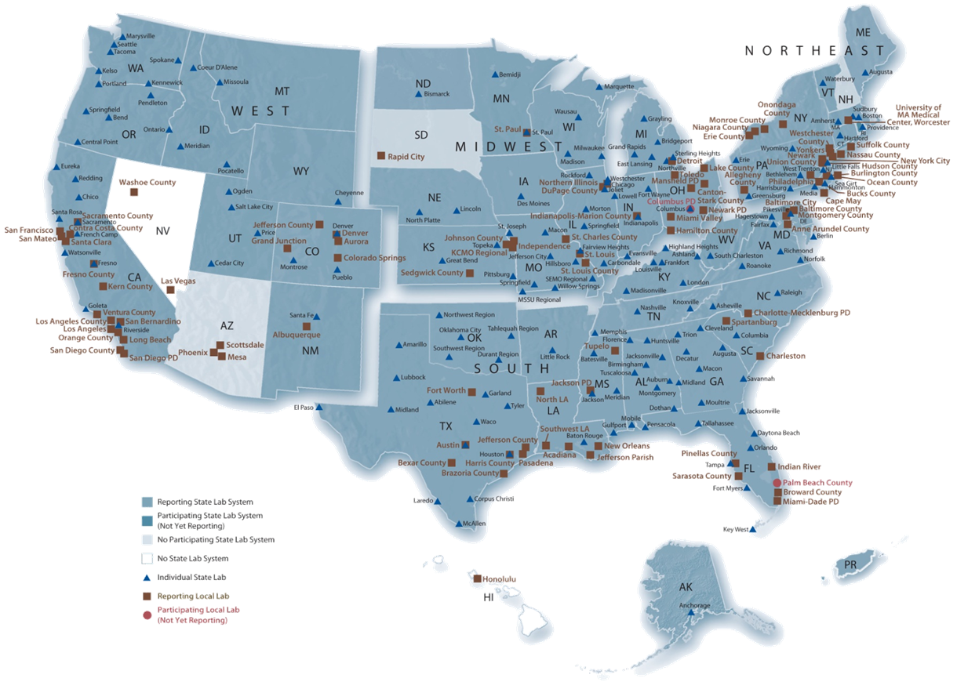
National Forensic Laboratory Information System NFLIS
91% all evidence from 273 participating labs from 49 states https://www.nflis.deadiversion.usdoj.gov

Slide 31
Most Commonly Abused Pharmaceutical Drugs

Slide 32
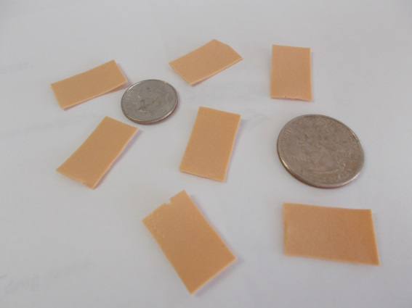
Top Four Narcotic Analgesics
Fentanyl (illicit) | 30.5%
Oxycodone | 15.46%
Buprenorphine | 10.33%
Hydrocodone | 9.26%
Source: National Forensic Laboratory Information System – 2018

Slide 33
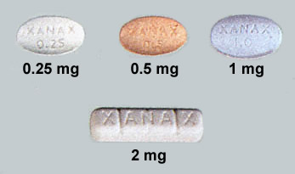
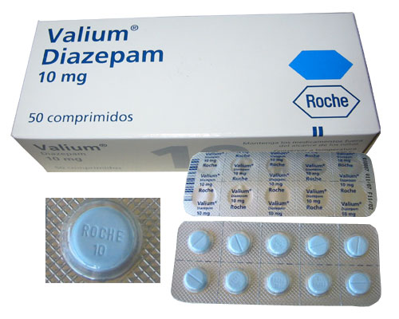
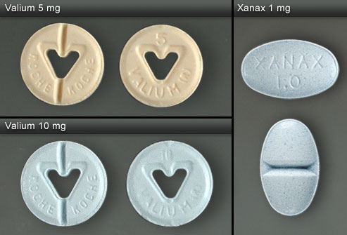
Top Three Benzodiazepines
Alprazolam (Xanax) 59%
Clonazepam (Klonopin) 14%
Diazepam (Valium) 5%
Source: National Forensic Laboratory Information System – 2018
Notes:
Xanax is the most commonly abused bezodiapane encountered by law enforcement.

Slide 34
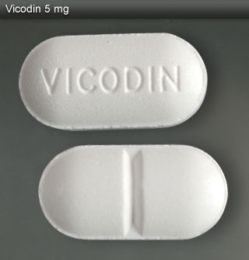
The Holy Trinity Prescription Drug Combination that Gives Heroin - Like - High
Hydrocodone – Vicodin/Lortab/Norco
Alprazolam - Xanax
Soma - Carisoprodol
No legitimate medical purpose

Slide 35
Other Common Drug Cocktails
Soma + codeine = “Soma coma”
Always changing
Gabapentin abuse

Slide 36
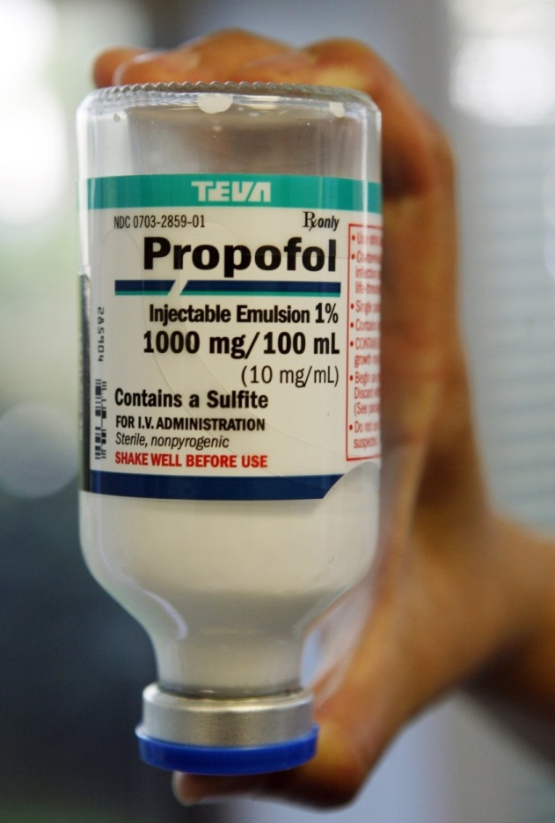
Propofol
Source: Los Angeles Times

Slide 37
Propofol
Non-controlled substance
DEA’s authority limited to controlled substances only
FDA determines medicines
DEA’s role primarily drug security, diversion & abuse
Liquid drug diversion
Tramadol scheduling in 2014
Eight factor analysis, DEA & FDA
Recordkeeping?
Propofol future?
https://www.deadiversion.usdoj.gov/fed_regs/rules/2014/fr0702.htm
Source: Los Angeles Times

Slide 38
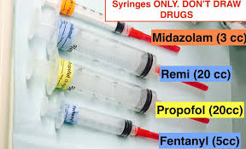
The Key ASC Drugs
It will always be about the opioid syringes
Fentanyl, oxycodone, etc.
And the benzodiazepines – Versed, etc.

Slide 39
Common Drug Abuser Characteristics

Slide 40
Common Drug Abuser Characteristics
They are not easily noticed and skilled at hiding their activity.
They are often the best workers who come in early, stay late, and volunteer to do extra work.
Only workers with access to drugs divert them. Not true.
While it's mostly nurses who divert drugs because their numbers are so large, people in every job description in the Mayo system have been caught diverting drugs.

Slide 41
Justice Department Announces Settlement Agreement with Seattle Cancer Care Alliance Over Pharmacy Control Failures July 7, 2016
WASHINGTON - The Department of Justice announced today that it has reached a settlement with Seattle Cancer Care Alliance (SCCA) relating to losses of more than 96,000 pills of oxycodone between 2011 and 2013. SCCA self-reported the diversions after discovering that a nurse employed at the cancer care center had used falsified and altered prescriptions to divert oxycodone from SCCA’s on-site pharmacy.
The nurse conducted the scheme by drafting prescriptions for patients who were formerly receiving care at the center, obtaining physician signatures on those prescriptions, and then altering the prescriptions to reflect higher quantities and doses before transmitting them to the on-site pharmacy to be filled.
The nurse would then pick up the controlled substances from the pharmacy under the guise that she was doing so as a service to the patient. Once her scheme was discovered, SCCA terminated the nurse’s employment. She subsequently took her own life.
https://www.justice.gov/usao-wdwa/pr/justice-department-announces-settlement-agreement-seattle-cancer-care-alliance-over

Slide 42
Common Drug Abuser Characteristics
Appearing at work on their day off.
Volunteering to administer drugs to patients.
Frequent trips to bathroom or locker room after administering of CS’s.
Unexplained absences from work station.
Falling asleep at work.
Mood swings.
Increasing absenteeism.
Preferring night shifts.
The heroin effect.

Slide 43
Common Drug Abuser Characteristics per DEA
Work absenteeism – absences without notification and an excessive number of sick days used;
Frequent disappearances from the work site, having long unexplained absences, making improbable excuses and taking frequent or long trips to the bathroom or to the stockroom where drugs are kept;
Excessive amounts of time spent near a drug supply. They volunteer for overtime and are at work when not scheduled to be there;
Unreliability in keeping appointments and meeting deadlines;
Work performance which alternates between periods of high and low productivity and may suffer from mistakes made due to inattention, poor judgment and bad decisions;
Confusion, memory loss, and difficulty concentrating or recalling details and instructions. Ordinary tasks require greater effort and consume more time;
Interpersonal relations with colleagues, staff and patients suffer. Rarely admits errors or accepts blame for errors or oversights;
Heavy "wastage" of drugs;
Sloppy recordkeeping, suspect ledger entries and drug shortages;
Inappropriate prescriptions for large narcotic doses;
Insistence on personal administration of injected narcotics to patients;
Progressive deterioration in personal appearance and hygiene;
Uncharacteristic deterioration of handwriting and charting;
Wearing long sleeves when inappropriate;
Personality change - mood swings, anxiety, depression, lack of impulse control, suicidal thoughts or gestures;
Patient and staff complaints about health care provider's changing attitude/behavior;
Increasing personal and professional isolation.
https://www.deadiversion.usdoj.gov/pubs/brochures/drug_hc.htm

Slide 44
Walk Me Through Some More Case Studies

Slide 45
Case Study #1

Slide 46
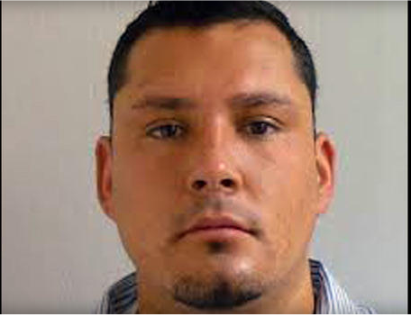
Multi-state Hepatitis Outbreak 2011
David Kwiatkowski
A cardiac technologist in 18 hospitals in seven states before being hired at New Hampshire's Exeter Hospital in 2011.
Had moved from job to job despite being fired at least four times over allegations of drug use and theft.
Since his arrest last year, 46 people have been diagnosed with the same strain of hepatitis C he carries.
Kwiatkowski admitted stealing the injectable painkiller Fentanyl and replacing them with saline-filled syringes tainted with his blood.
Sentenced to 39 years in prison
How a nurse defeated him
https://www.newsweek.com/2015/06/26/traveler-one-junkies-harrowing-journey-across-america-344125.html

Slide 47
Case Study #2

Slide 48
Charles City (Iowa) Nurse Anesthetist Sentenced to Nearly Three Years in Federal Prison for Drug Tampering and Diversion Scheme May 29, 2020
Replaced Dozens of Vials of Fentanyl with Saline in a Hospital’s Surgery and Birthing Centers
From February 2018 through September 7, 2018, Scott West used his State of Iowa nursing licenses to gain access to two controlled substances, fentanyl and sufentanil, by perforating tamper-proof paper around the vials, carefully opened the vials, replacing the drugs in the vials with saline, gluing the vials shut, and placing the vials back in the hospital’s secure dispensaries in the surgery and birthing centers.
The hospital discovered West’s scheme on September 7, 2018, when a hospital visitor discovered West passed out in a public bathroom. West had a rubber tourniquet and empty and full vials of propofol, another drug used in anesthesia, in his coat pocket.
A prior review of West’s obstetrics patients in 2018 revealed that one in four of West’s spinal anesthesia patients received narcotics that were insufficient to reduce labor pain, such that the women giving birth also required general anesthesia.
https://www.justice.gov/usao-ndia/pr/charles-city-nurse-anesthetist-sentenced-nearly-three-years-federal-prison-drug

Slide 49
Case Study #3

Slide 50
Hepatitis Outbreak – Colorado 2009
A surgical tech who infected at least 18 hospital patients with hepatitis C by stealing liquid painkillers and leaving behind her dirty syringes was sentenced to 30 years in prison.
Stole laid out fentanyl and replaced with saline tainted with her blood.
Parker admitted stealing syringes from operating carts while employed at Denver's Rose Medical Center and Colorado Springs' Audubon Surgery Center.
https://www.cbsnews.com/news/surgery-tech-kristen-parker-gets-30-years-for-infecting-36-patients-with-hepatitis-c/

Slide 51
Case Study #4

Slide 52
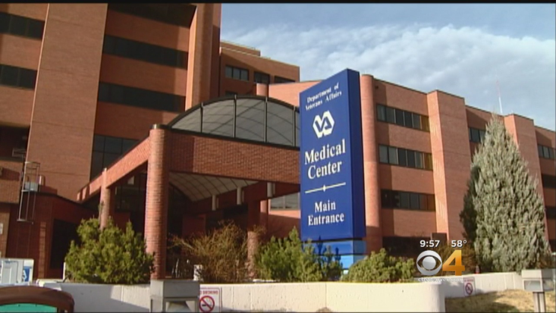
Nurses sentenced to prison for stealing opioids from Colorado hospitals May 1, 2018
Lisa Marie Jones, 43 of Castle Rock, and a nurse was sentenced to 14 months imprisonment for stealing waste from VA hospital and replacing syringes back into ADM.
Marlene Gilmore, 28 of Wellington, and a nurse was sentenced to four months for stealing fentanyl, morphine and hydromorphone from the locked automated medication management system.
https://www.justice.gov/usao-co/pr/nurses-sentenced-prison-stealing-opioids-colorado-hospitals

Slide 53
Other Examples
An endoscopy nurse drops syringes of fentanyl into a secret pocket in her uniform top and substitutes them with syringes containing saline.
A night custodian rummages through sharps waste containers and consolidates minuscule remaining fentanyl vials for his own use.

Slide 54
What’s the Solution?

Slide 55
Mayo Clinic Response The Gold Standard
Created D-Dirt, the Drug Diversion Intervention and Response Team led by a special diversion coordinator.
Have a zero tolerance policy
Make friends with law enforcement
Employ a 24-hour diversion hotline
Employ a waste retrieval system
Throw out assumptions about healthcare workers who divert drugs
Know and keep track of areas
Report it.
Make sure hospital leaders understand
Offer treatment once an employee is caught and terminated.

Slide 56
OR?

Slide 57
Minnesota DOH - 2012
https://www.health.state.mn.us/facilities/patientsafety/drugdiversion/docs/divroadmap041812.pdf

Slide 59
Minnesota DOH – 2015 6 page - 102 point checklist
https://www.mnhospitals.org/Portals/0/Documents/ptsafety/diversion/Road%20Map%20to%20Controlled%20Substance%20Diversion%20Prevention%202.0.pdf

Slide 60
Minnesota DOH – 2015 Page 1
https://www.mnhospitals.org/Portals/0/Documents/ptsafety/diversion/Road%20Map%20to%20Controlled%20Substance%20Diversion%20Prevention%202.0.pdf

Slide 61
Minnesota DOH – 2015 Summary
SAFE – Safety teams, Access to information, facility expectations, educate staff
Storage and security
Procurement
Prescribing
Preparation & dispensing
Administration of CS
Handling CS waste
Monitoring of CS & process if diversion is suspected
https://www.mnhospitals.org/Portals/0/Documents/ptsafety/diversion/Road%20Map%20to%20Controlled%20Substance%20Diversion%20Prevention%202.0.pdf

Slide 62
Minnesota DOH Webpage Drug Diversion Resources
https://www.mnhospitals.org/quality-patient-safety/quality-patient-safety-improvement-topics/medication-safety/drug-diversion

Slide 63
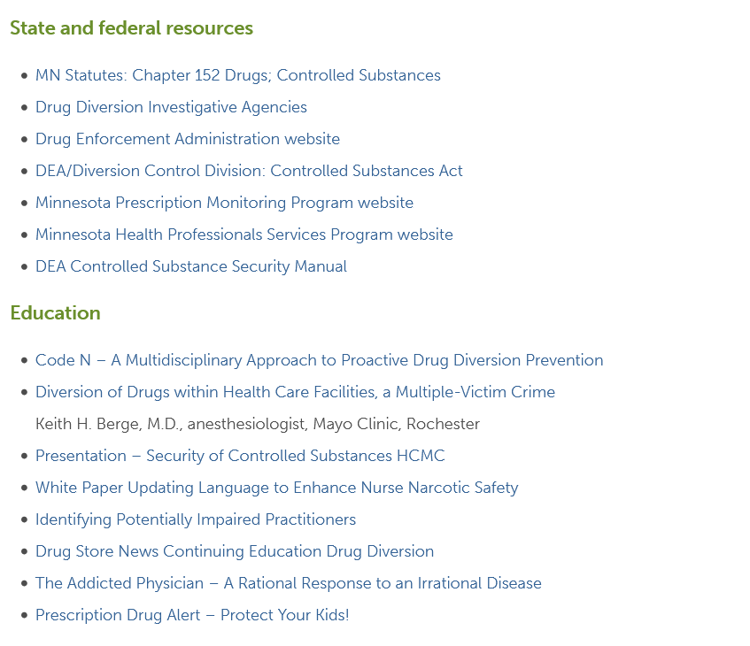
Minnesota DOH Webpage Drug Diversion Resources
https://www.mnhospitals.org/quality-patient-safety/quality-patient-safety-improvement-topics/medication-safety/drug-diversion

Slide 64
Walk Me Through the Keys

Slide 65
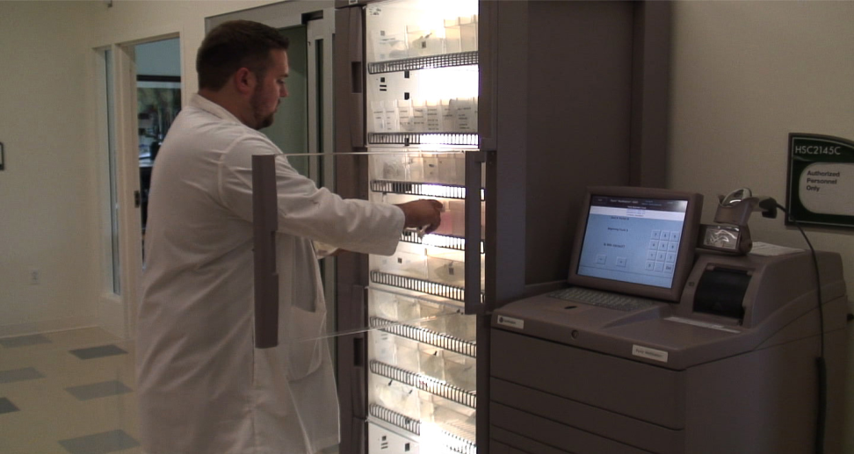
Walk Me Thru the Fix 1st Steps
Create the Drug Diversion Team and oversight group.
Team should include nurse, pharmacist, compliance person & attorney.
Institute pharmacist in charge (overall recordkeeping responsibilities.)
Focus on opioid syringes access, use and wasting. Use “rule of two’ whenever possible. Don’t lay out opioid syringes. (Hep C possibilities)
Focus on ADM machines – recordkeeping and security. (Hep C & diversion)

Slide 66
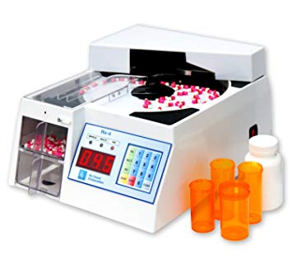
Walk Me Thru the Fix 1st Steps
Register all locations where CS’s are kept and minimize if possible.
Conduct inventory and document. Continue with audits at least quarterly.
Implement recordkeeping as needed along with tracking software.
Consider implementing tip line.
Institute training program once policies are developed.
Screen new employees for drug usage.

Slide 67
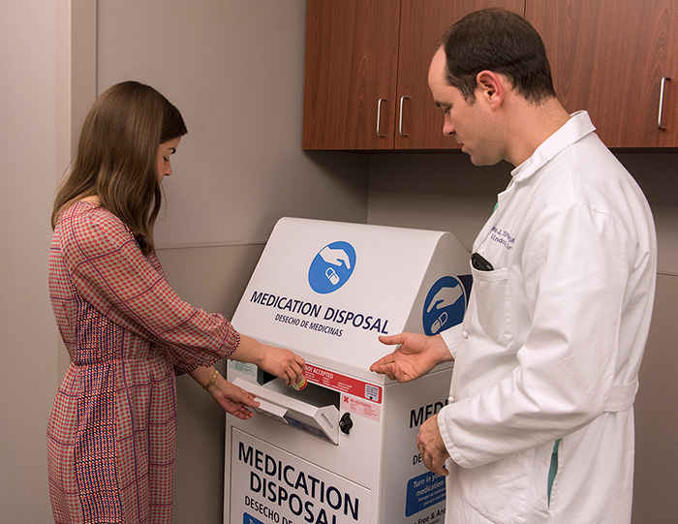
Walk Me Thru the Fix 2nd Steps
Conduct annual drug tests on all high risk employees if possible.
Install cameras in ADM locations & pharmacies.
Make it difficult to take needles inside restrooms. Pocket rule?
Place wasting receptacles inside surgery areas.
Pharmacy staff or other should empty wasting receptacles and compare numbers.

Slide 68
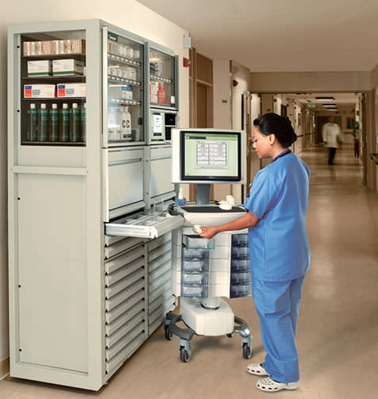
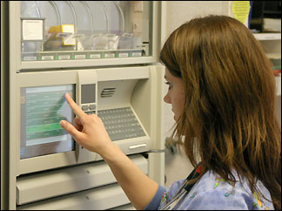
Walk Me Thru the Fix 2nd Steps
Reconcile ADM usage daily if possible by separate review & review for anomalies.
Look closely at ADM cancellations and have them “time out” quickly if possible.
Terminate access to ADM immediately once a person leaves organization.
Change passwords on ADM’s every 90 days.
Implement separations of duties – person who orders drugs doesn't receive drugs.
Cancel discharged patients from records quickly.

Slide 69
Walk Me Thru the Fix Follow-up Steps
Constantly review safeguards for improvements and stay current.
Assign one person to interface with DEA if ever needed - Pharmacist or CCO.
Consider conducting mock or tabletop DEA audit.
Consider outside annual audits & reviews.
Update training on drug prevention and organizational policies.
Develop policies.
Offer treatment for those in need.

Slide 70
Key Takeaways from Cases
Must have PIC (Pharmacist in Charge) or equivalent
Review usage of drugs by medical personnel
Maintain strong oversight of drugs
Use rule of two for drug wasting
Act when drugs are missing
Limit access to drug vaults & servers
Maintain perpetual inventory

Slide 71
Other Resources

Slide 72
Baker Tilly White Paper
https://ahia.org/AHIA/media/WhitePapers/WHITEPAPER_BakerTilly_Drug-Diversion-Internal-Audit_AHIA.pdf pages 14 to 17

Slide 73
New Updated Pharmacist’s Manual (October 2020)
Easy to read
References all of the drug recordkeeping requirements
Defines “significant loss”
Defines drug breakage/ spillage and how to document
Very good reference document
Keep on file?
https://www.deadiversion.usdoj.gov/pubs/manuals/(DEA-DC-046)(EO-DEA154)_Pharmacist_Manual.pdf

Slide 74
New Updated Pharmacist’s Manual (October 2020)
Significant Loss
“Although the CSA and the regulations do not define the term “significant loss,” it is the responsibility of the registrant to use his or her best judgment to take appropriate action. Whether a “significant loss” has occurred depends, in large part, on the business of the pharmacy and the likelihood of a rational explanation for a particular occurrence. What would constitute a significant loss for a pharmacy may be viewed as comparatively insignificant for a hospital or manufacturer.”
“If it is determined that the loss is not significant, DEA recommends that the registrant place a record of the occurrence in a theft and loss file for future reference. Miscounts or adjustments to inventory involving clerical errors on the part of the pharmacy should not be reported on a DEA Form 106, but rather should be noted in a separate log at the pharmacy management’s discretion.”
https://www.deadiversion.usdoj.gov/pubs/manuals/(DEA-DC-046)(EO-DEA154)_Pharmacist_Manual.pdf page 65

Slide 75
New Updated Pharmacist’s Manual (October 2020)
Breakage and Spillage
“The witnessed breakage or spillage of a controlled substance does not constitute a loss of controlled substances because the registrant can account for the controlled substances. These types of incidents do not require notification to DEA. If there is breakage, spillage, or other damage to controlled substances, but the controlled substances are still recoverable, there are options for disposing of them:”
“If the breakage or spillage is clearly observed, but the controlled substances are not recoverable, the registrant should document the circumstances of the event in his or her records. It is DEA’s position that in order to maintain complete and accurate records in accordance with 21 CFR 1304.21(a) that non-recoverable breakage or spillage must be recorded on a DEA Form 41 and, as with any other form of disposal under 21 CFR Part 1317, should be signed by two individuals who can testify that a breakage or spillage occurred. These records must be maintained in the registrant’s files and contain such information as required by 21 CFR 1304.22(c).”
https://www.deadiversion.usdoj.gov/pubs/manuals/(DEA-DC-046)(EO-DEA154)_Pharmacist_Manual.pdf page 66

Slide 76
DEA Resources/Links DEA Form 41
https://www.deadiversion.usdoj.gov/online_forms_apps.html

Slide 77
The Required Records
POA’s for II’s
Initial Inventory
Biennial Inventory
Closing Inventory
Receiving Records, 222’s or invoices – 2 year federal retention
Distribution Records
Theft and Loss Records – 106’s
Drug Destruction & Returns -41
Prescriptions vs Dispensing & Administering
https://www.deadiversion.usdoj.gov/pubs/manuals/(DEA-DC-046)(EO-DEA154)_Pharmacist_Manual.pdf pages 35 & 36

Slide 78
Wrap it UP

Slide 79
All Everything Summary CFR 1301.71(a) All applicants and registrants shall provide effective controls and procedures to guard against theft and diversion of controlled substances.
MN 2015 Road Map | DEA Recordkeeping Requirements | Other
SAFE – Safety teams, Access to information, facility expectations, educate staff | POA’s for II’s | DEA Security – cameras , safes, access
Storage & Security | Initial Inventory | Policies
Procurement | Biennial Inventory (perpetual inventory) | Hiring
Prescribing | Closing Inventory | Drug Testing
Preparation & Dispensing | Receiving Records, 222’s or invoices – 2 year federal retention
Administration | Distribution Records, Dispensing & Administering (perpetual inventory)
Handling CS Waste | Theft and Loss Records – 106’s
Monitoring of CS & process if diversion is suspected | Drug Destruction & Returns -41

Slide 80
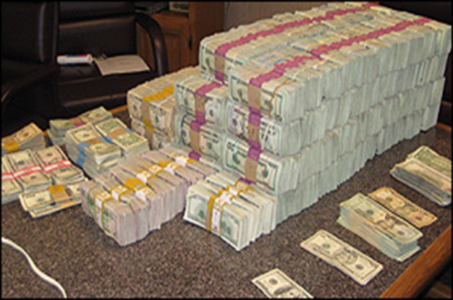
Safeguards & Risk Mitigation for ASC’s
Maintain robust security and recordkeeping for CS’s
Limit the locations and access to CS’s
Use the “rule of two” in high risk situations – before and after use of opioid syringes
Key threat – opioid syringes
Follow national/state/best practice guidelines whenever possible - MN
Practice due diligence & have a process/policies

Slide 81
Hospital Pharmacy Key Takeaways
Create drug diversion team
Must have PIC (Pharmacist in Charge)
Review usage of drugs by medical personnel.
Maintain strong oversight of ADM’s. ***
Use rule of two for drug wasting
Anticipate that liquid opioids will diverted and plan accordingly
Act when someone is caught replacing with saline
Limit locations where drugs are kept and track drugs from beginning to end.
Review usage of drugs by medical personnel
Limit access to drug vaults & servers
Maintain perpetual inventory
Conduct training, at hire and annually
Implement drug testing, at hire and unannounced
Maintain strong security over returned and wasted drugs
Develop policies

Slide 82
Questions?
Dennis Wichern
312-859-2430
Dennis.wichern@prescriptiondrugconsulting.com

